Slide 1
Introduction to Effective Strategies for Literacy, including dyslexia
Liz Ross - Specialist Teacher

Slide 2
Objectives:
To increase your understanding of literacy difficulties, including dyslexia
2. To increase your understanding of effective strategies in literacy
3. To increase your confidence in using these strategies

Slide 3
Activity - What is Dyslexia?
Each of the next eleven slides contains a
sentence about dyslexia. Some are facts,
Some are opinions.
What do you think?

Slide 4
There is one definition of
dyslexia that is universally
agreed

Slide 5
Dyslexia exists in all languages

Slide 6
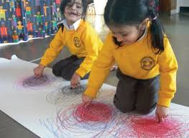
Dyslexia is all about motor skills, movement
and co-ordination

Slide 7
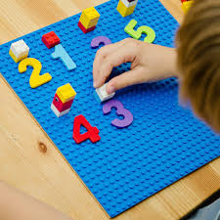
If you have dyslexia you will have difficulties
with maths

Slide 8
Dyslexia is a difficulty with vision

Slide 9
E.P.
Dyslexia has to be diagnosed by an
Educational Psychologist

Slide 10
Dyslexia runs in families
“A friend of mine has dyslexia and her son
has too, so I think so!”

Slide 11
CYP with dyslexia will have low self-esteem

Slide 12
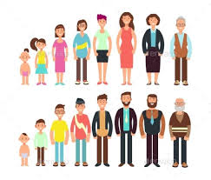
If you have dyslexia, you have it for life

Slide 13
The term `dyslexics’ is preferred

Slide 14
Having dyslexia means the school gets additional funding and they have to read and scribe for the CYP. They are more likely to get an EHCP as well.

Slide 15
KCC Dyslexia Policy
Included in the policy:
A working definition of dyslexia
Guidance on identification of dyslexia
https://www.kent.gov.uk/__data/assets/pdf_file/0003/63579/Dyslexia-Policy.pdf

Slide 16
Working Definition of Dyslexia
“Dyslexia is evident when accurate and fluent word reading and/or spelling develops very incompletely or with great difficulty, despite appropriate learning opportunities – that is, learning opportunities which are effective for the great majority of children.”
(British Psychological Society, 1999)

Slide 17
Kent Dyslexia Policy
Identification:
‘Teachers can identify children with Dyslexia.’
‘Good practice is to have a named person who has had further training in Dyslexia or literacy difficulties.’
‘A ‘diagnosis’ from external specialists does not have to be carried out.’

Slide 18
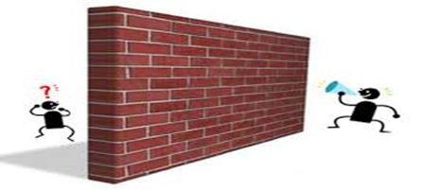
Barriers to Learning
Activity - Read and copy the learning objective on the next slide

Slide 19
اللى يشوف بلوة غيره تهون عليه بلوت.

Slide 20
Self Esteem
Empathy and understanding
Encouragement to persevere
Look for success in other areas
https://www.literacynet.org/mi/assessment/findyourstrengths.html

Slide 21
Self Esteem
Catch and reward, good behaviour choices
Be specific with praise and evidence it

Slide 22
Effective Strategies

Slide 23
MCS
https://www.kelsi.org.uk/__data/assets/pdf_file/0019/56521/MCS-Cognition-and-Learning.pdf

Slide 24
The Staged Process of Assessment

Slide 25
Other Possible Reasons for Low Literacy Attainment
How many can you think list?
(eg. motivation, attendance)

Slide 26
Targeted and Personalised Support
To further support literacy attainment, key skills to
target are as follows:
Phonological Awareness (synthetic phonics)
code knowledge
blending
segmenting
phoneme manipulation
syllabification
2) Verbal memory and processing

Slide 27
Code knowledge - Phonemes
How many individual sounds do you think
are in the English language?
A) About 1,000
B) About 44
C) About 400

Slide 28
Code Knowledge - Graphemes

Slide 29
B-l-e-n-d-i-ng
Listen to the sounds on the recording for this
slide and in your head, push/blend them
together, in order .
Which word do you get?

Slide 30
S-e-g/m-e-n/t-i-ng
Can you split/segment (like an orange) the
word on the recording into it’s individual
sounds (phonemes) ?

Slide 31
Phoneme Manipulation
Being able to swap sounds in and out of
words.
Think about the two words below and see
how quickly you can say the two new words
you get, when you swap initial sounds
between them.
Chip Shop

Slide 32
Syl/ la/ bi/ fi/ ca/ tion
Identifying syllables in words

Slide 33
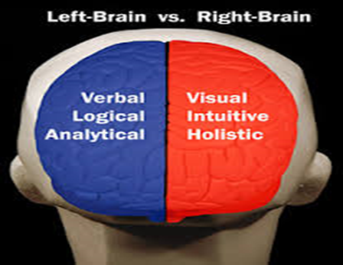
Verbal Memory and Processing
Test yourself

Slide 34
Further Support
Whole word reading/spelling
eg.flashcards, LCWC, letter boxes,

Slide 35
Further Support
Comprehension – phonic
books AND real books

Slide 36
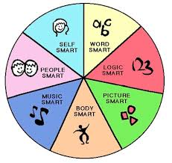
Further Support
Check that the support matches the CYP’s
learning profile

Slide 37
In Summary
The Facts
There isn’t a universally agreed definition of dyslexia,
but there is agreement on two characteristic features –
phonological awareness and verbal memory and
processing. The KCC Dyslexia Policy follows an
educational model of dyslexia and the focus is on word
level reading and/or word level spelling skills
Dyslexia exists in all languages
Difficulties with motor skills, movement and co-ordination are not characteristic features of dyslexia

Slide 38
In Summary
The Facts
Having difficulty with maths is not a characteristic feature of dyslexia
Having visual difficulties/finding coloured filters useful isn’t a characteristic feature of dyslexia
Educational Psychologists aren’t needed for dyslexia assessments anymore. Teachers with further training in dyslexia can assess for dyslexia and determine the CYP has dyslexia
Dyslexia runs in families for about 50% of cases. Research is ongoing.

Slide 39
In Summary
A CYP with dyslexia won’t necessarily have low self-esteem but this should be carefully monitored
If you have dyslexia you may have it for life – the debate continues
The internationally agreed phrase is `person WITH dyslexia’
A determination of dyslexia doesn’t come with any additional support

Slide 40
In Summary
Effective intervention/support is key
This effective support will be
For the characteristic difficulties of dyslexia
For whole word reading and spelling
For comprehension
For any other area of difficulty identified in the CYP’s learning profile

Slide 41
Thank You
liz.r@st-Nicholas.kent.sch.uk for any questions about this training
Nichola.P@st-Nicholas.kent.sch.uk for the reflection form

