Slide 1
Autism Awareness Online Training
Katy Harrington
Specialist Teaching and Learning Service
Canterbury and Coastal District

Slide 2
Autism Awareness
Brief introduction to ASC
Social Communication & Interaction
Sensory
Transition
Active Engagement
Emotional Regulation

Slide 3
“If you’ve met one person with autism, you’ve met one person with autism.” (Dr Stephen Shore)
Get to know your pupil
Build relationships
Have high expectations

Slide 4
Watch this brief video from the National Autistic Society. Either: 1. Click on the picture above to open the hyperlink 2. Copy and paste this into your web browser https://www.youtube.com/watch?v=Lk4qs8jGN4U 3. Go to Youtube and search for ‘What is Autism NAS’ and it should be the first video that comes up.
What is Autistic Spectrum Condition?
Notes:
4

Slide 5
DSM-5 defines Autism as:
“persistent difficulties with social communication and social interaction” and “restricted and repetitive patterns of behaviours, activities or interests” (this includes sensory behaviour)”
Notes:
5

Slide 6
Social Communication & Interaction
Key Support Strategies.
Let’s focus on the following key areas:
Sensory
Transitions
Active Engagement
Emotional Regulation

Slide 7
Autism Awareness
Social Communication & Interaction
Sensory
Transition
Active Engagement
Emotional Regulation
Brief introduction to ASC

Slide 8
Social Communication & Interaction
Verbal and Non-verbal communication
Expressive and Receptive communication
Notes:
8

Slide 9
Social Communication & Interaction: Impact in School
Follow instructions and understand what is going on in lessons Play games with their classmates Join in tasks involving team work Make inferences | Autistic pupils might find it difficult to… | Ask for the equipment they need, for a break, to go to the toilet, for help etc. Have conversations with people (e.g. not knowing when to speak or to stop speaking) Make and keep friends
Notes:
9

Slide 10
Social Communication & Interaction: Strategies
Understanding
Cue their attention first before communicating something to them.
(e.g. say their name)
Reduce/simplify your language.
Use concrete, precise language.
(e.g. “I’ll do it in a minute” → “1, 2, 3…60!”; “It’s raining cats and dogs” → “No it isn’t!)
Notes:
10

Slide 11
Social Communication & Interaction: Strategies
Understanding
Repeat instructions if necessary and check their understanding.
Use visual supports to support verbal language.
(e.g. gestures, signs, written instructions etc.)
Read page 17 of text book
Answer questions 1, 2 and 3.
Show teacher
Notes:
11

Slide 12
Social Communication & Interaction: Strategies
Expression
Be responsive to pupils’ attempts to communicate and give them time to talk about their interests.
Give them time to respond to you.
Provide visuals to support communication
e.g. teach them how to use a ‘Help Card’
Notes:
12

Slide 13
Social Communication & Interaction: Strategies
Social Skills
Teach them social rules they find confusing (e.g. through role play or social stories)
Help them to foster friendships, for example through:
Buddy systems (for younger pupils)
Linking them up with pupils with similar interests
Setting up lunch/break time clubs around their interests
It is important that we support children to socialise in the way that they want to, not in the way we think they should!
Notes:
13

Slide 14
Autism Awareness
Sensory
Transition
Active Engagement
Emotional Regulation
Brief introduction to ASC
Social Communication & Interaction

Slide 15
Can you label these seven senses?
Sensory

Slide 16
Can you label these seven senses?
Sensory
Olfaction: our sense of smell
Vision: our sense of sight
Gustation: our sense of taste
Vestibular: our sense of movement and balance
Proprioception: our sense of where we are in space
Somatosensory: our sense of touch
Audition: our hearing sense
There is also an important 8th sense: Introception. This is our sense of what is going on inside our bodies (e.g. knowing if we are hungry, hot, need the toilet etc.)

Slide 17
Sensory
Our senses give us information about the world around us.
Many autistic people have difficulty processing sensory information.
Any of their senses can be Hyper (Over) sensitive or Hypo (Under) sensitive (or both at different times).

Slide 18
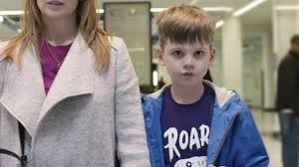
Sensory
Watch this short video from the National Autistic Society to see the enormous impact that this can have on a person’s everyday life.
Either: 1. Click on the picture here to open the hyperlink 2. Copy and paste this into your web browser https://www.youtube.com/watch?v=aPknwW8mPAM
3. Go to Youtube and search for ‘NAS Can you make it to the end’ and it should be the
first video that comes up.

Slide 19
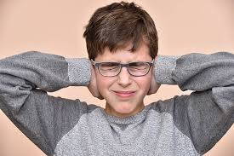
Sensory: Impact in School
Smells of body odour in the gym
The light shining in on the whiteboard
Schools can be a very overwhelming environment.
Lots of people in the corridors
Steep stairs to the classroom
The hum of the computer or overhead projector
Limited choices for school dinner
The feel of the school jumper
Notes:
19

Slide 20
Sensory: Strategies
If a sensory checklist has not already been completed for the pupil(s) you work with, this will be the first step.
Ideally this should be done by home as well as school.
This will enable you to get a full picture of the pupil’s sensory needs.

Slide 21
Sensory: Strategies
TACTILE | yes | no | Don’t know | Child’s reaction
Avoids casual touch by peers or adults
Craves physical contact
Hugs very tightly
Distressed by messy hands
Dislikes certain textures
Craves certain textures
Sucks/chews clothing
Sucks/chews self
Sucks/chews objects
Removes clothing
Prefers bare foot
Distressed at hair brushing, teeth cleaning
Dislikes cold
Dislikes hot
Craves cold
Craves hot
Disturbed by vibration
Tactile stims – tapping, rubbing, squeezing, banging, scratching
This is an extract from the St Nicholas School Sensory Assessment Checklist.
Alternative checklists are available e.g. from the Autism Education Trust.

Slide 22
Sensory: Strategies
From the analysis of the sensory checklist a sensory diet might be needed for the pupil. This might include:
Daily sensory circuits
Regular physical breaks throughout the day
Changes to the physical environment (e.g. move where they sit in class)
Creating a sensory box containing alerting and calming resources to encourage pupils to regulate their own sensory needs

Slide 23
Sensory
This training has only looked at sensory needs very briefly. We would recommend that you complete the STLS Sensory Training for more detailed guidance.

Slide 24
Autism Awareness
Transition
Active Engagement
Emotional Regulation
Brief introduction to ASC
Social Communication & Interaction
Sensory

Slide 25
Transition
Autistic people often like familiarity and routine. This is because they can find it challenging to predict other peoples’ behaviour, imagine situations outside their routine and generalise experiences outside of their normal routine.
Making transitions and coping with change can be very challenging.
Pupils have to make lots of transitions throughout the day.
Notes:
25

Slide 26
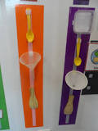
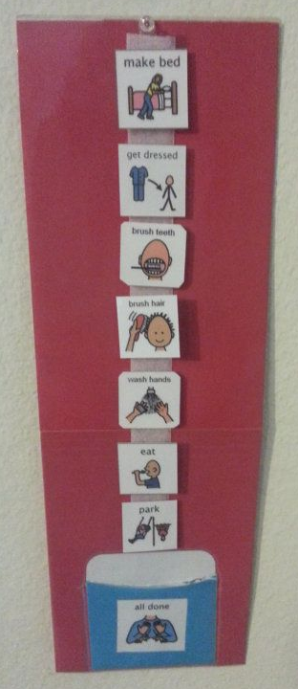
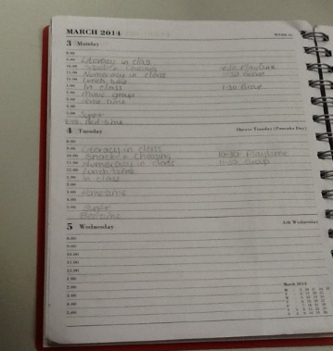
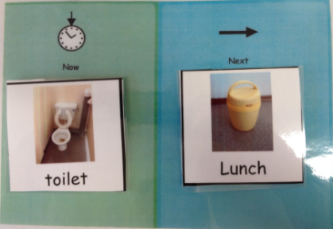
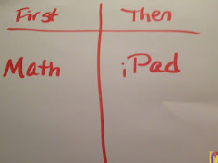
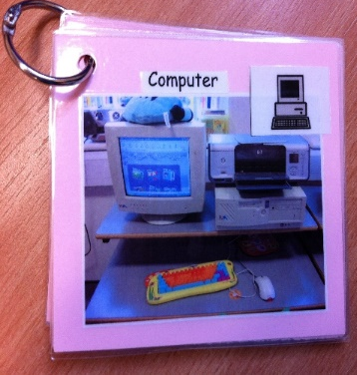
Transition: Strategies
Pupils should have a visual timetable to help them predict what will happen next and to let them know of any changes to their normal routine. Here are some examples:
Objects of reference
A symbol timetable
Use a timetable that is appropriate for the individual pupil’s level of understanding.
Diary or list
Now/next board
Photo keyring
Notes:
26

Slide 27
Transition: Strategies
Some other things to think about…
Allow pupils time to complete activities
Show the pupil a clear start and end to the task (e.g. timers)
Allow pupil to go to the next room/area earlier to avoid the crowd
Consider the pupil’s motivation to do the upcoming task
Prepare the pupil for changes in routine
Notes:
27

Slide 28
Autism Awareness
Active Engagement
Emotional Regulation
Brief introduction to ASC
Social Communication & Interaction
Sensory
Transition

Slide 29
Active Engagement
Sometimes a pupil might need some extra support to engage with learning activities. This might be because:
They do not understand the work
They are not interested or motivated by the work
They do not see the purpose of it

Slide 30
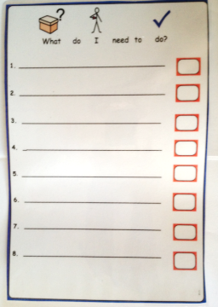
Active Engagement: Strategies
Provide any supports a pupil needs to help them understand and complete activities successfully. For example:
- Clear visual instructions (such as a step-by-step task checklist)
An example of a finished piece of work (Blue Peter effect!)
- Give pupils additional preparation time (e.g. pre teach key vocabulary; a chance to read the book in advance etc.)

Slide 31
Active Engagement: Strategies
Think about how the pupil records their work. If writing is difficult, could they do it differently? For example:
- Typing
- Speech to text software
- Having a scribe

Slide 32
Active Engagement: Strategies
Use pupils’ interests/hobbies in activities as much as possible.
E.g. If the class are learning how to write a letter or newspaper article, could they write it about their favourite topic?

Slide 33
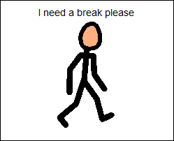
Active Engagement: Strategies
Think about how long an activity will take to complete and if the pupil needs any physical breaks.
Have a system in place e.g. can the pupil ask for a break whenever they need one?
Remember, a physical break does not need to be long and can take place in the classroom.

Slide 34
Active Engagement: Strategies
Immediately follow the activity with something more motivating.
Reward systems can be useful. The class system may not be enough. Pupils might need something more personalised.
Things to consider:
- It needs to be easy to understand
- Rewards need to be motivating
- They should not have to wait too long for their reward

Slide 35
Autism Awareness
Emotional Regulation
Brief introduction to ASC
Social Communication & Interaction
Sensory
Transition
Active Engagement

Slide 36
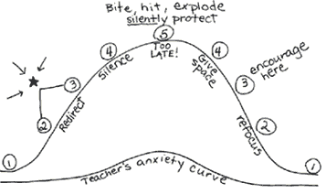
Emotional Regulation
The Anxiety Curve (Buron & Curtis)
Reactive
Most of what we should do is at number 1
i.e. the preventative work.
Preventative

Slide 37
Emotional Regulation: Strategies
I get anxious when:
There is a change to my routine
I am bored
People shout or raise their voices to me
To calm down, I like to:
Be given time and space
Be offered a choice of books
Get to know the pupil(s) you work with.
Do you know
What makes them anxious?
How you can tell if they are feeling anxious?
What strategies work to reduce their anxiety?
This could be shared on a pupil profile.
Insert pupil photo here
Likes & Motivators:
Trampoline
Puzzles
Reading
Spinning wheel in the playground
Giant slinky
Doing jobs in the classroom and around school
Music
When I’m anxious I might:
Push past people
Make loud noises and cover my ears
Clap my hands and jump up & down
Grab adults
Spit in bins
I communicate by:
- Signing and PECS Phase 4

Slide 38
Emotional Regulation: Strategies
Ensure they have easy access to things that help to regulate them.
Include breaks throughout the day as part of their regular routine and give them permission to take breaks when they are starting to feel dysregulated.
They may need a visual support to request breaks.
If they are unable to recognise when they need a break, you will need to recognise those early signs of dysregulation and model it for them.

Slide 39
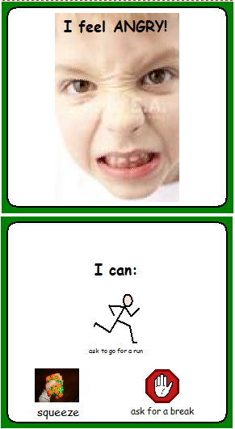
Emotional Regulation: Strategies
‘I need a language for my worries’
Pupils need to learn to identify and communicate their emotions.
Explore and label their feelings and your own
(e.g. “You look happy!)
Emotions keyrings

Slide 40
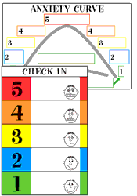
Emotional Regulation: Strategies
The Incredible 5 Point Scale
Can be used to teach students how to identify and manage their own emotions & behaviours.
SEE THE STLS ‘5 POINT SCALE’ ONLINE TRAINING FOR FURTHER INFORMATION!

Slide 41
Autism Awareness
Brief introduction to ASC
Social Communication & Interaction
Sensory
Transition
Active Engagement
Emotional Regulation

Slide 42
Reference and for further information:
www.autism.org.uk (The National Autistic Society website)
www.autismeducationtrust.org.uk
Ten things every child with Autism wishes you knew: Ellen Notbohm
M is for Autism: The students of Limpsfield Grange School and Vicky Martin
Helping young children with autism to learn - A practical guide for parents and staff in mainstream schools and nurseries: Liz Hannah
Understanding your child’s sensory signals: Angie Voss
Inclusion Development Programme: supporting pupils on the autism spectrum
The Reason I Jump: Naoki Higashida
www.thegirlwiththecurlyhair.co.uk A social enterprise which supports people on the autistic spectrum and the people around them. Links to blog, books, animations etc.
Contact me if you have any questions:
Katy.h@st-nicholas.kent.sch.uk

