Slide 1



A Guide To Using Visuals
Katy Harrington
Specialist Teaching and Learning Service
Canterbury City and Coastal District

Slide 2
Aims of the session:
To understand why we recommend using visuals to support pupils.
To look at a variety of examples of visual tools that you can use.

Slide 3

What visual supports do you rely on in your everyday life?

Slide 4


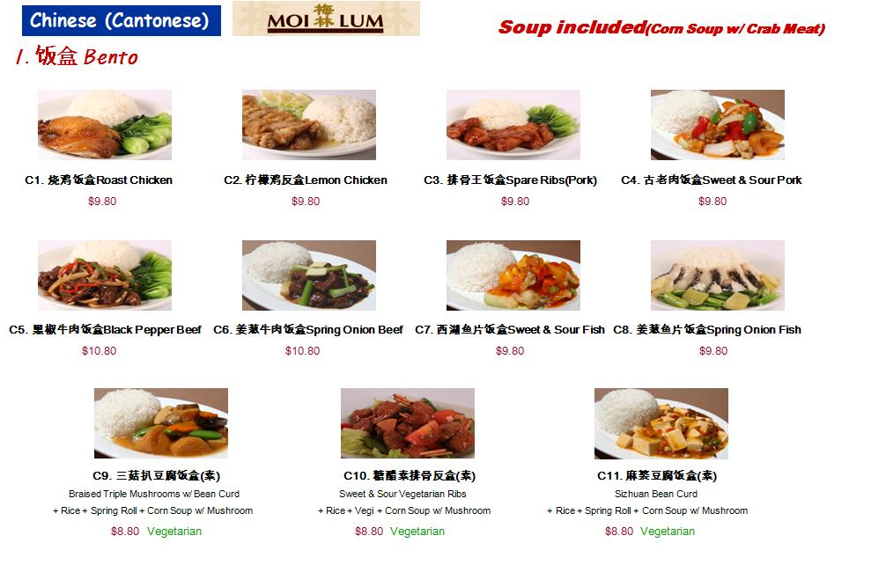



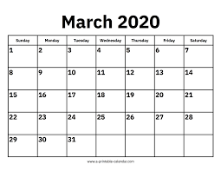

Body movements
Environment
Could you cope without these everyday visual supports?
Personal organisational tools

Slide 5
Visuals are used to:
Support pupils' understanding
Support pupils' communication
Support progression and learning
Reduce anxiety
Promote independence

Slide 6
Why are visuals so important?
It is easier to process visual than verbal information
Visuals reinforce verbal language
Visuals are permanent
Visuals slow things down, give the pupil time to focus and process the information
Can be understood by a wider audience
They make abstract concepts more concrete

Slide 7

Visuals help everyone in the class!

Slide 8
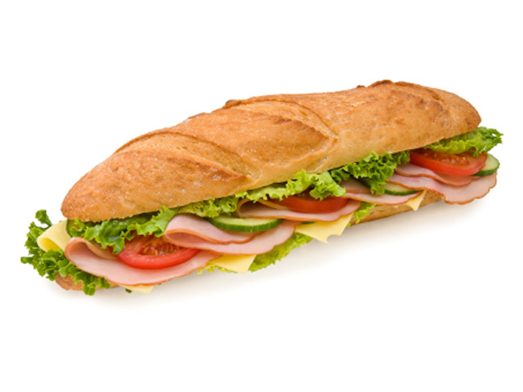


There are different forms of visual supports that can be used:
Objects
Photographs
Symbols
Black and white symbols
Written words

Slide 9

Visuals should be:
Key Principles
Used consistently.
Progressed rather than reduced.
Appropriate for the pupil's level of understanding.
Managed by the pupil as far as possible to promote independence.

Slide 10
What visual supports are you already providing for your pupils?

Slide 11

Example Visuals:
hkjhkjhAAasd

Slide 12
Visual timetables
Support transitions
Help pupils understand what will happen next
Let them know of any changes to their routine, ahead of time
Reduce anxiety
Promote independence

Slide 13
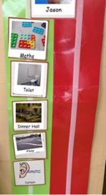
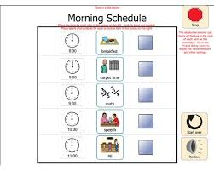
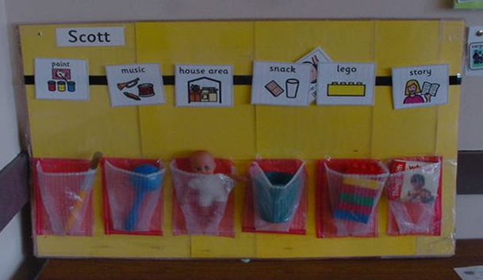
Visual timetables – part day

Slide 14
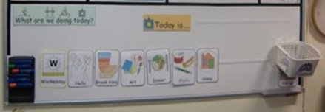
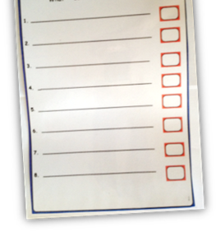
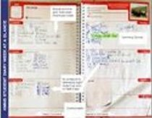
Visual timetables – full day

Slide 15

Visual timetables – coping with changes
Use the visual timetable to prepare pupils for changes to their routine.

Slide 16
Visual timetables – advice
Use a timetable that is appropriate for the pupil's level of understanding.
Have it where it can be reached and used.
Make sure the pupil is involved.
Have the resources ready, and make sure it is changed at the right times.

Slide 17
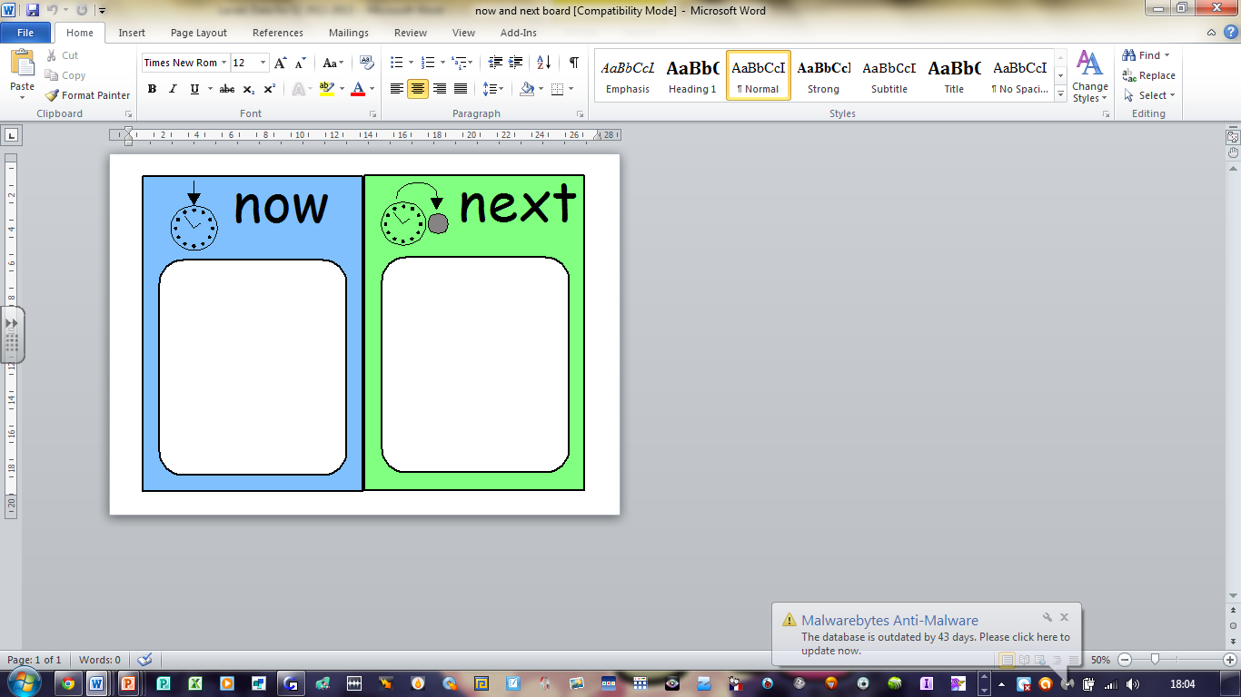
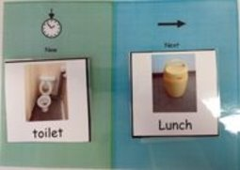
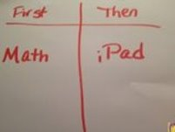
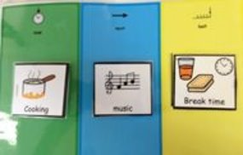
Now and Next boards
AA

Slide 18

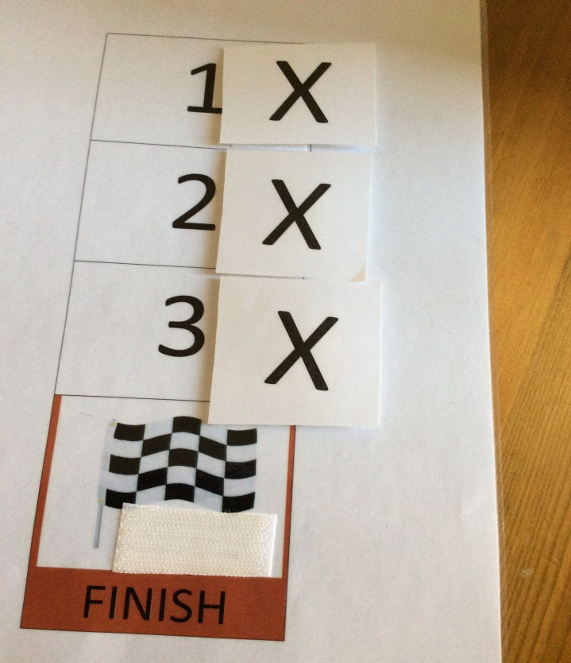

Defining the time
Visual countdown
Egg Timer
Countdown strip

Slide 19
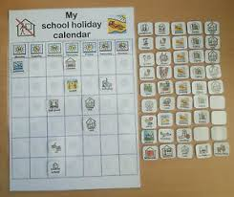
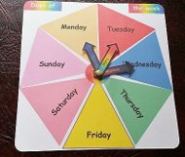
Defining the time
School holiday calendar
Days of the week

Slide 20
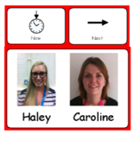
'Working with' board

Slide 21
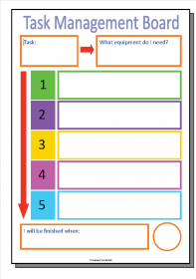
Task Management Boards
The main aim is to develop independence.
Also supports planning and sequencing skills.
They can see when their task will end!

Slide 22
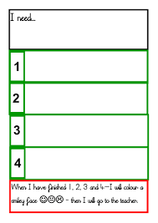
Task Management Boards
1. Check pupil understands vocabulary used.
2. Read through visual support together.
3. Initially work through each step together.
4. When more confident, ask them to do one of the steps alone.
5. Gradually increase the amount they are doing independently.

Slide 23

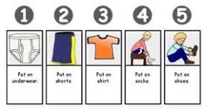
Task sequence strips:
Use of visuals to support pupils to follow familiar routines with greater independence
Getting dressed
Going to the toilet

Slide 24
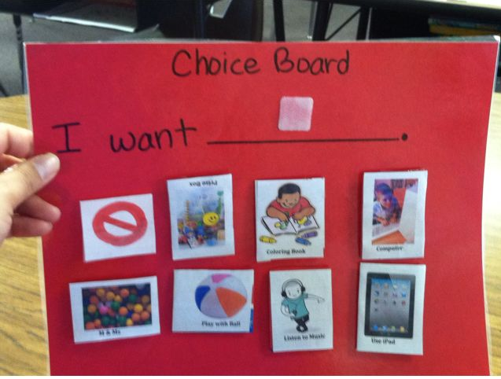
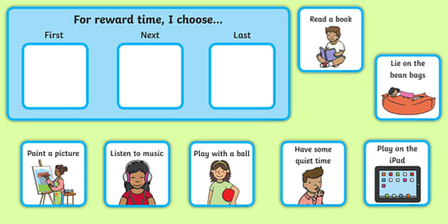
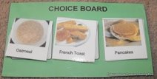
Choice boards

Slide 25
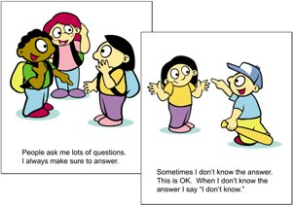
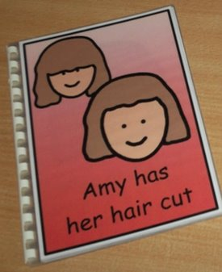
Social Understanding: social stories
A short visual story written in a specific format
Describes what happens in a specific social situation
Describes what people do and why they do it and what the common responses are

Slide 26
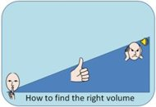

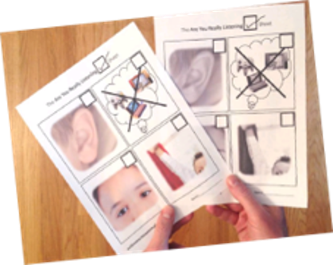
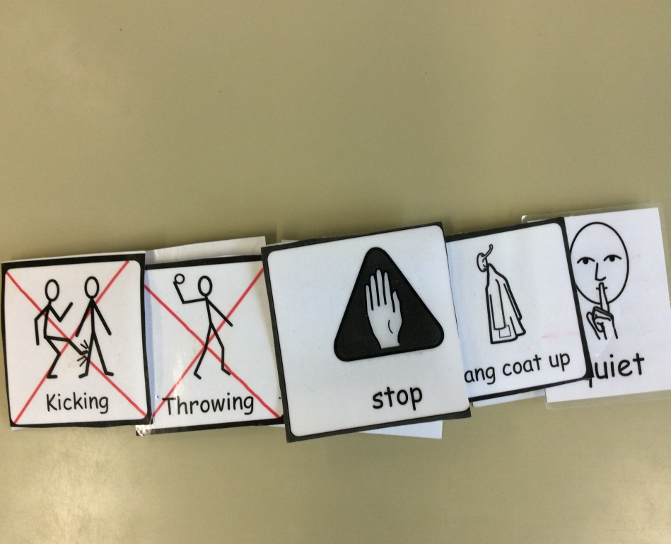
Social Understanding: Visual Reminders

Slide 27
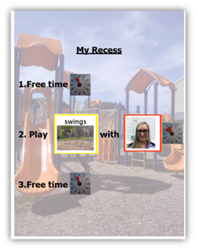
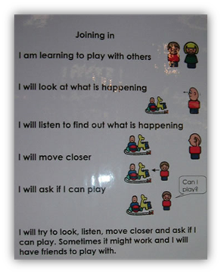
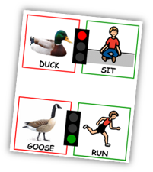
Social Understanding: Play times

Slide 28
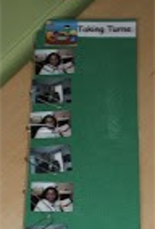
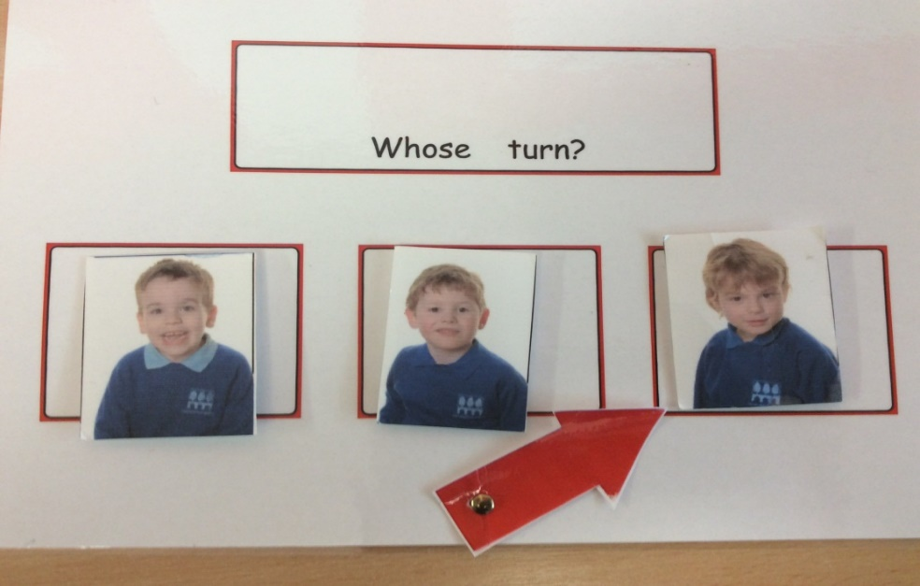
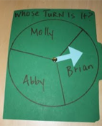

Social Understanding: turn-taking

Slide 29

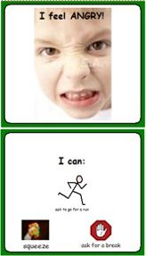
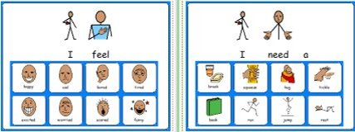
Emotions

Slide 30
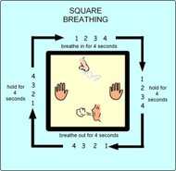




Emotions
Break cards
Transition objects
Visual to support breathing technique

Slide 31
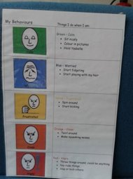
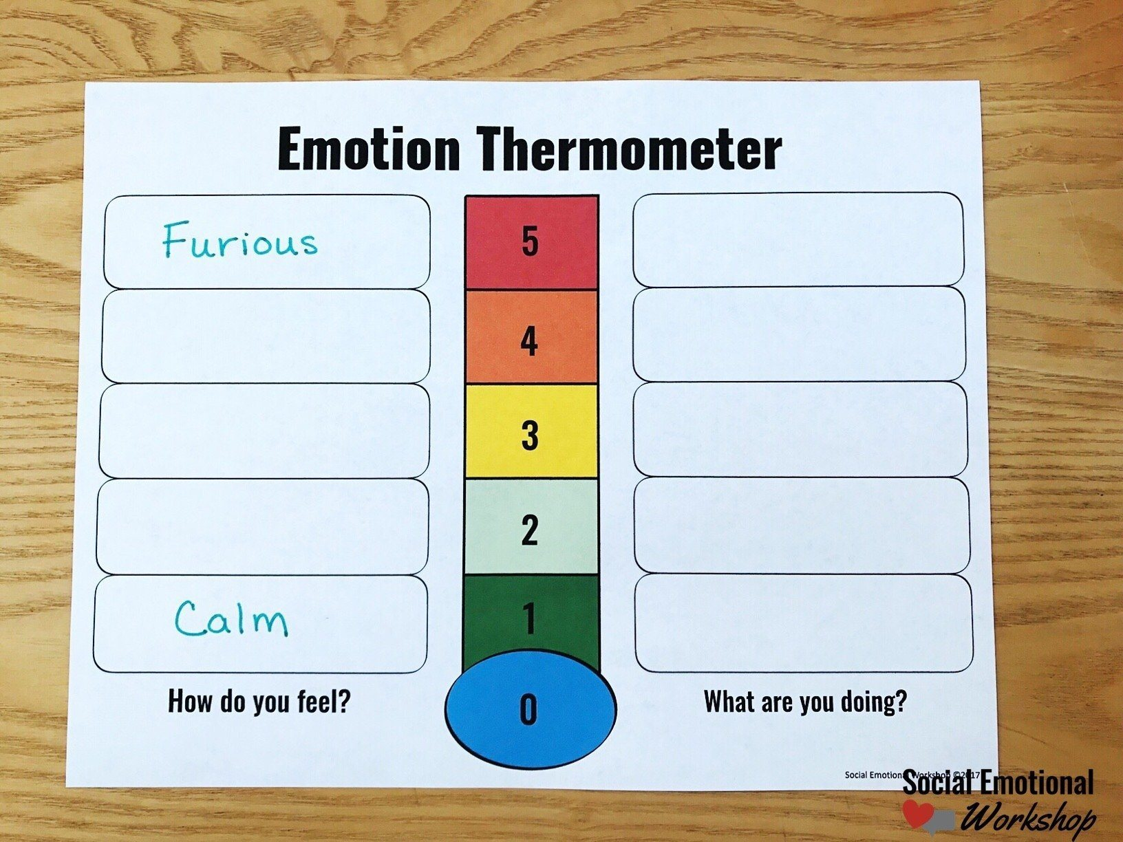
Emotions
The Incredible 5-Point Scale

Slide 32

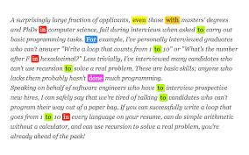
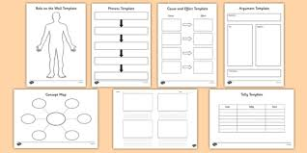
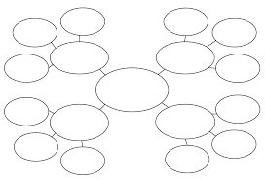
Supporting understanding of information

Slide 33
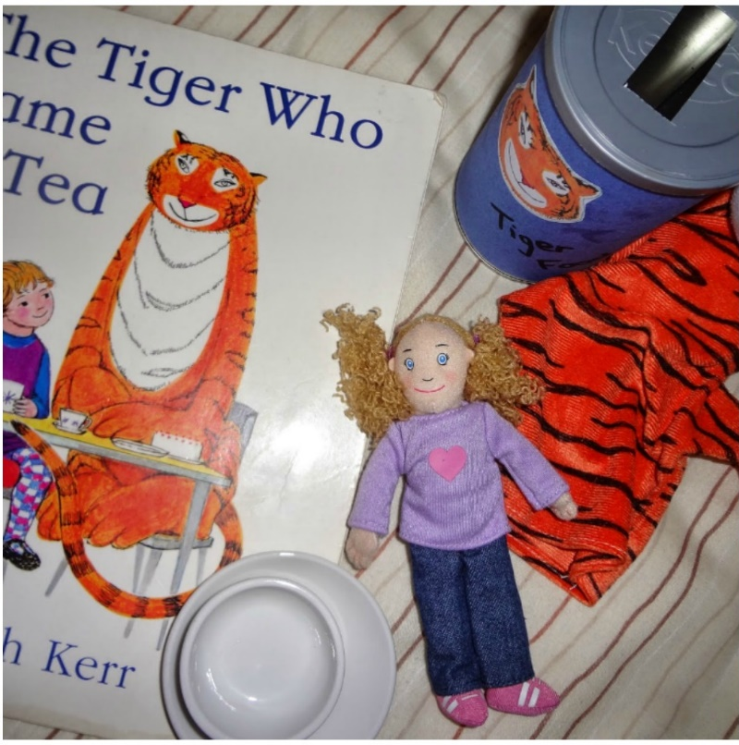
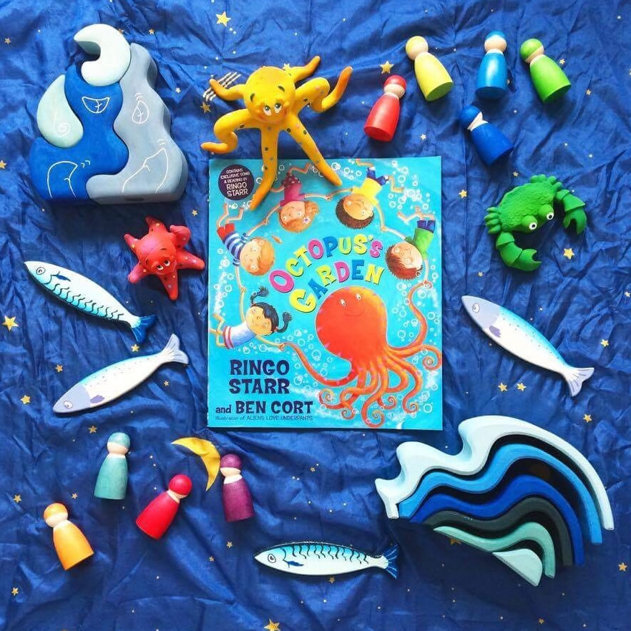
Using visual props to support engagement with stories

Slide 34
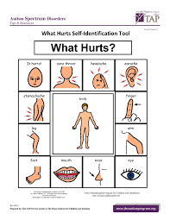


Supporting communication
Asking for help
Communicating what hurts

Slide 35
Language Through Colour
Question | Type of information | Colour
Who | Person | Pink
What | Thing | Orange
What - doing | Action | Yellow
Where | Place | Blue
What - like | Description | Green
When | Time | Brown
Why | Reasons | Purple
How | Description of verb | Dotted yellow
A colour-coded system to support pupil's expressive and receptive language

Slide 36
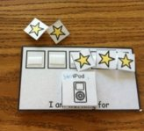
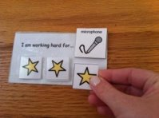
Reward Charts

Slide 37
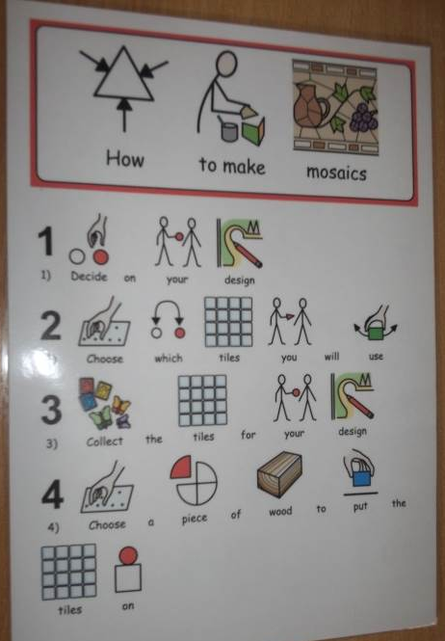
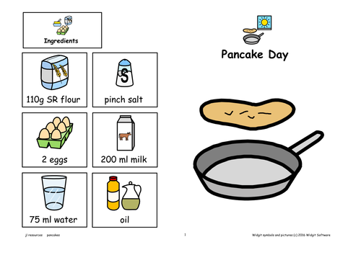
Symbol supported instructions
Worksheets and recipes

Slide 38
Some practical points to consider:s
Laminate where possible for longer use.
How will they be stored?
But visuals don't always have to be perfect!
Ensure the visuals are in a noticeable place for the pupil to refer to.

Slide 39
Reference and for further information:
https://www.autism.org.uk/advice-and-guidance/topics/communication/communication-tools/visual-supports (Link to information from the National Autistic Society on Visual Supports)
https://carolgraysocialstories.com/social-stories/what-is-it/
The New Social Story Book – Carol Gray
Contact me if you have any questions:
Katy.h@st-nicholas.kent.sch.uk
Say less, show more!

