Slide 1
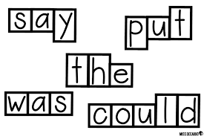
Whole Word Approaches
Liz ross – specialist teacher, with a focus on cognition and learning

Slide 2
Objectives
To increase your understanding of the phrase `whole word approach’
To increase your understanding of the most effective whole word approaches
To increase your confidence in using the whole word approach to support children/young people (CYP)

Slide 3
Reading and Spelling
Debate about the most effective strategies to support reading and spelling date back to the 16th century
Research in 2006 – Independent Review of the Teaching of Early Reading – Jim Rose concluded that systematic synthetic phonics offers the vast majority of CYP the best and most direct route to becoming skilled readers and writers
2007 - Letters and Sounds sent to all schools
So, do you think we use our phonological skills to read all words?

Slide 4
Please read
Acocrding ot reaserhc hte shpae fo hte wrod si moer improtnat ofr raednig htan hte lettres bieng ni hte ritgh ordre. Yuo raednig thsi provse thta

Slide 5
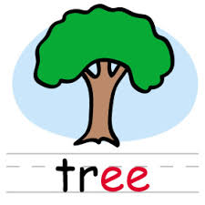
The Whole Word Approach and Phonics
The Whole-word Approach teaches CYP to read by sight and relies upon memorization via repeat exposure to the written form of a word paired with an image and an audio
So when do we support CYP to use the whole word approach and when synthetic phonics?
Memorization involves both the visual short-term memory and visual sequential memory

Slide 6
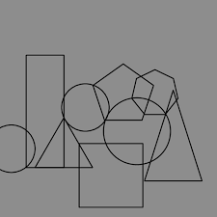
Visual Short-term Memory

Slide 7
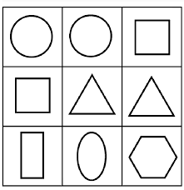
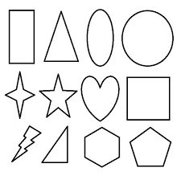
Visual Sequential Memory

Slide 8
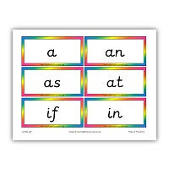
High Frequency Words
Did you know that the hundred highest frequency words make up about 40% of all reading and writing?

Slide 9
The Twenty-Five Highest Frequency Words
no so go is on
It can in do me
up an you am the
and we my he like
to at see a I

Slide 10
Different Whole Word Approaches
Look Cover Write Check (LCWC)
Simultaneous Oral Spelling (SOS)
Cued Spelling
Mnemonics
Neuro-Linguistic Programming (NLP)
Own Voice
Morpheme Training
Precision Teaching
As we look at each approach, think which ones would best support you learning to spell the word chiaroscurist

Slide 11
LCWC
1. The CYP looks at the target word for a few seconds
2. The CYP then covers that word
3. They then write the word
4. They then check it against the original spelling
5. This process is repeated until the CYP has written it correctly, a few times

Slide 12
SOS
1. Spelling Partner says the target word, on it’s own, then in a sentence, then on it’s own, again. CYP writes it
2. If the word is wrong, the spelling partner writes the word correctly, saying each letter name as they write it and asking the CYP to watch and listen as they do this
3. Spelling partner takes away the word they wrote and asks the CYP to write the word and say each letter’s name as it is written
4. Spelling partner asks the CYP to read what they have written as a whole word and then checks it is correct. If not, the process is repeated again

Slide 13
Cued Spelling
1. The CYP chooses a word from their list of words to learn to spell
2. The spelling partner helps the CYP to copy the word correctly
3. The spelling partner reads the word and puts it in a sentence. The CYP then reads the word and puts it in a sentence
4. The spelling partner helps the CYP to choose cues (what do you notice about the patterns in the word, any rule that might apply, a mnemonic etc) to aid memory of the spelling. Spelling partner writes these down
5. The spelling partner and the CYP say the cues together
6. The CYP says the cues as the spelling partner writes the word
7. The spelling partner says cues as the CYP writes the word
8. The CYP says the cues and writes word
9. The CYP writes the word as fast as they can and then reads it

Slide 14
Mnemonics
Can take any form and use either whole word or phonics approaches
For example, the word because:
Via phonics – big elephants can’t always use small exits
Via Letter names – They can learn to say the letter names in this word in two sets so that they rhyme: BEC AUSE
Via art -

Slide 15
Letter Boxes and Word Shapes

Slide 16
Own Voice
1. The CYP writes the target spellings
2. For each word that is wrong, the CYP records themselves saying the word, then the individual letter names, on a device
3. The CYP listens to the recording and writes the word again, afterwards
4. The CYP then checks the spelling and repeats the process as necessary

Slide 17
Precision Teaching
1. The spelling partner provides the CYP with a set of 10-15 target words on cards and sets a session target (which ensures success early on)
2. Set a timer for 20 seconds
3. CYP reads the words aloud to the spelling partner. If the word is unknown it is put to one side
4. When the timer sounds, reading stops and the number of words read in the time allowed is recorded on the chart
5. The result is compared to the session target. If the target has not been reached the timer is reset and reading begins again
6. When the session target is reached the CYP is praised
7. Records of performance over time are kept so the CYP can compare and celebrate their learning

Slide 18
NLP
The spelling partner writes the target word on a piece of A5/A4 paper, having checked that the CYP can read the word and put it in a sentence
The spelling partner asks the CYP to look really carefully at the word, for about ten seconds, trying to take a `mental photo’ of it, so that they can see it in their head when they close their eyes
The spelling partner then asks the CYP to read the letter names in order, five times and backwards once
The spelling partner takes the word away and asks the CYP to write the word
If it’s incorrect, repeat the process

Slide 19
Morpheme Training
A morpheme is the smallest unit of meaning in a word. A word such as unforgettable has 3 morphemes un-forget-able, running has 2 run(n)-ing. Words have roots, and affixes: ‘run’ is the root, ‘ing’ is the affix. Words are often morphemically regular even when they are not phonically regular, for example ‘magic’ and ‘magician’
The root of chiaroscurist is chiaroscuro

Slide 20
In Summary
There are two approaches we use when reading and spelling words – phonics and the whole word approach (and we can use memory aids via both approaches)
The whole word approach relies on visual memory – both short-term and sequential. These abilities can be trained if they are weak
There are many different whole word approaches and the best strategy is to find one that the CYP feels works best

Slide 21
Thank You
Please e-mail Nickie at N.PerringRedford@stns.or.uk to request an evaluation form and certificate

