Slide 1

Precision Teaching
Liz Ross
Specialist Teacher, with a focus on Cognition and Learning
Notes:
Hello and welcome to this training. It will probably take you less than an hour to go through the slides and activities. Relax. Do it at your own pace.

Slide 2

Objectives
To increase your understanding of Precision Teaching
To increase your confidence in using Precision Teaching
Notes:
May have come across it before. EP and Specialist Teachers often recommend it as part of an intervention, but it’s not actualy teaching, even though that word is in the title. I will explain this more in the next few slides.

Slide 3
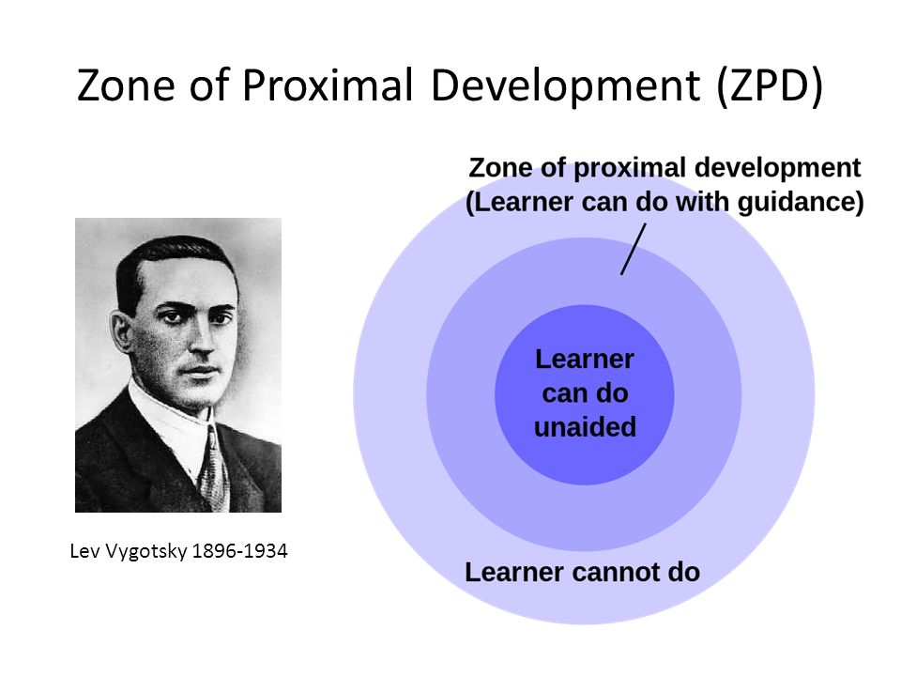
Philosophy
Vygotsky- zone of proximal development -
by providing a learning situation that is largely familiar
and mainly within the child’s competence, you support the
child to learn the ‘next little bit’
Notes:
The Soviet Scientist Vygotsky talked about the zone of proximal learning and precision teaching is based on this principle and was developed in the 1960s, at Harvard University, by Ogden Lindsley (Lindsley, 1990). So what is the zone of proximal learning. As is illustrated above, any task set for someone can be put into one of three categories – tasks that the learner can do unaided – within the leraner’s competence, tasks that the learner can do with guidance – tasks that are manily withing the learners competence and tasks that the learner can’t do – outside their competence.
The zone of proximal learning will grow and shrink dependent on various factors, inclufing how confident the learner feels.
To give you an ex – copy of a Kandinski – no!
It grew out of the tradition of behaviourism. A timer, record charts and self-monitoring are some of the crucial components of Precision Teaching, a method which stresses the need for the learner to become automatic, fluent and effortless in what he does.

Slide 4

What is it?
Precision Teaching was developed in the 70’s to target fluency of key skills
It can be useful for CYP who have reached a plateau in learning and for whom other methods of teaching haven’t supported sufficient progress
Notes:
As I mentioned, it forms part of an intervention – it goes alongside a teaching session. It helps support fluency of the key skills taught in that teaching session.
On the second point – ex. Working memory difficulties or building confidence – low self-esteem
It involves a set of target stimulus, a timer, a probe sheet (with the stimulus repeated several times on it) and a record sheet. I will explain this in more detail later.

Slide 5

What can you use it for?
Any simple stimulus-response learning eg. HFWs, key words (reading and spelling), number facts (times tables, number bonds)
Notes:
*The ex.s I use later are HFWs but you can use it with any stimulus – response situation

Slide 6

What it doesn’t do
It is not teaching
It is not a class or group intervention- it can only be done on a one-to-one basis
It doesn’t support generalisation
Notes:
* The generalisation needs to be supported beyond the precision teaching session and I will explain this more later.

Slide 7

Preparation
Think about external factors, attendance, Xmas etc.
Allow time for a teaching session/s and a precision teaching/probe session
Notes:
Ideally this intervention should run for 2 weeks every day consistently. So, need to think about the CYP’s attendance and things like school holidays and plan for this.
* So it’s 2 sessions a day – teaching bect in am and probe in pm

Slide 8

Preparation
Decide on the area of learning:- times tables, sight words, number bonds, spellings, code knowledge etc.
Find out what the child already knows in this area
Decide on the next learning step eg. 2 more sight words.
Notes:
Preparation is probably the hardest part of precision teaching. Need to get this right.
Baseline – If the CYP tends to demonstrate inconsistent performance (maybe attention and listening skills or diff.s with self-regulation) do several times and work out core stimilui they know
Rememmebre it’s about securing the next small step in the learning. So 2 more sight words may not seem like very much, but it is

Slide 9
The Probe
Create a bank of stimuli, most known, some unknown.
Transfer these words onto a randomised probe. (Put the phrase `John Taylor freebies probe sheet’ into a search engine to access free probe generating software)
Notes:
Again, supporting the next step in learning and supporting it successfully, so about 70-80% of stimuli need to be known – with the learner’s competence.
Don’t need to use this software. Can design it yourself. The important thing is that the stimuli are repeated a few times on the probe sheet and be aware of the number of cells in the probe sheet, as it is timed – must base it on your baseline data to scaffold for success.

Slide 10
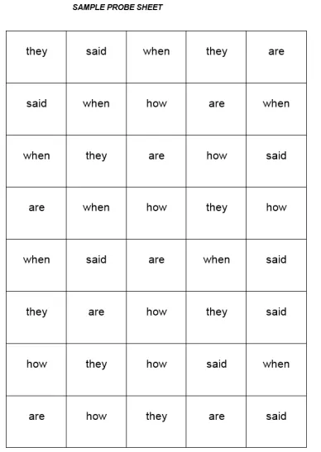
Example of a Probe for HFWs
Notes:
So I have used 5 HFWs here. 3 the child knew (could read instantly without hesitation) and 2 they didn’t. Each stimuli is repeated 8 times – so a 40 cell probe – based on the child’s speed in the baseline, 1 minute assessment. (They read about 40 words per minute.)

Slide 11
Recording
Give the CYP one minute to respond to as many stimuli as possible. Record how many correct responses and how many errors
Plot the responses on the record sheet
Notes:
I don’t always record the errors but focus on the correct resonses. More positive. But idea with errors is that the CYP sees them going down in nhmber over the sessions. Ex recording sheet on next slide, but again you can design your own.
*BE CAREFUL with the target line – must be attainable. It’s great if they go over it, so be conservative. I’ll explain this more on the next slide.
I tend to do three targets – personal best – more than their previous correct responses, the target line and the max (but don’t talk about that unless they hit it as it may be an unrealistic expectation. Some CYP work it out for themselves and aim for it
CYP should be doing the recording - ownership

Slide 12

Notes:
This is an example of a record sheet. If u look at the bottom of the sheet…idea is that the trend – the line joining the marks is upward for the correct responses and downwards for the incorrect and that this is a concrete visual illutaration to the learner that they are doing well – evidence!
– again, you can design your own, but if your want to us ethis one, you can print it off from the next slide

Slide 13
Print off a master copy of the Record Sheet
Open this link by double clicking on it and then print a copy off – that’s just for you to use as a master sheet

Slide 14
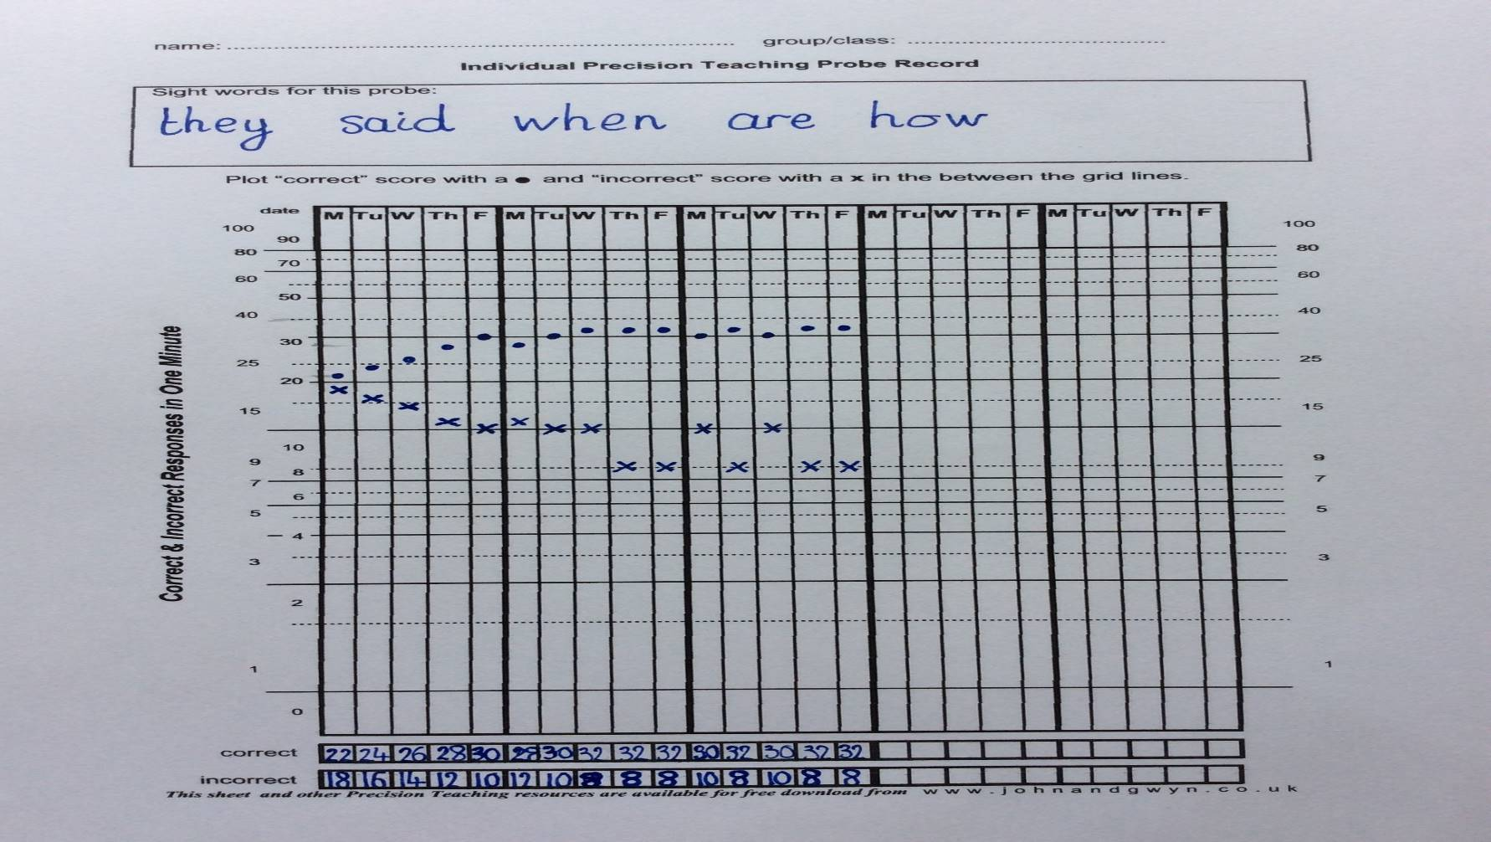
An Example of a Completed Record Sheet
Notes:
From the probe sheet earlier, a child had the following results. 22/40 correct on first sessiona nd 18 incorrect, so targets I set for the child were…
After 2 weeks you would review progress and decide whether to continue.. Just have a close look at this record sheet and decide whthere the intervention should be continued. Actually this child was struggling with `they’ so I switched it out for another HFW and she got 40/40 the next week.

Slide 15

Other Considerations
Revisit skills that had become fluent recently through precision teaching, so that the skills are maintained
Make sure that these skills are also included in other aspects of the school day, to support transference. For example, create sentences to be read and word problems to be solved
How long do you keep going with the precision teaching intervention?
Notes:
Cyclical pattern of revision is ideal
As I said, generalistaion of the key skills isn’t supported by p teaching, so it needs to be part of your planning ex – target words on desk, plan reading so the CYP needs to read it in a sentence, or ??
2 weeks and review. It can get boring.

Slide 16

In Summary
Precision Teaching is a very effective intervention to support fluency of a key skill
It doesn’t teach understanding of the key skill
It requires careful planning
Notes:
If you don’t remember anything else, these are the key points of this training.

Slide 17
Thank You
Please e-mail Nickie at
N.PerringRedford@stns.org.uk to be sent a certificate and evaluation form
Notes:
Hope u enjoyed it. Don’t be frightened to give it a go. U can alwys explain to the CYP that it’s a new intervention and would they mind trialling it with you and if t doesn’t go well – take the blame and say you will try it again another time and ask them what they think.

