Slide 1
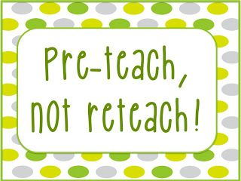

Pre-Teaching
Effective ways to use pre-teaching to support learning
Canterbury Specialist Teaching and Learning Service

Slide 2

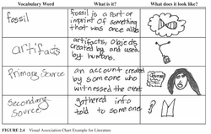
WHAT IS PRE-TEACHING?
Pre-teaching is the teaching of the language learners need before an activity.
Pre-teaching refers to the teaching of certain skills or vocabulary that would be needed for a lesson. This is often done in a session prior to the actual teaching, and can be helpful for students who might struggle to access or follow a lesson.
Pre-teaching is what happens in advance of the main event i.e. the task. This could be a reading, writing, listening or speaking task.

Slide 3

Why use Pre-teaching?
Pre-teaching is a way of setting children and young people up for success. Some children or young people can often find themselves in situations that are alien to them or that can cause extreme pressure, anxiety or stress. Not understanding certain situations or tasks can cause some children or young people to react inappropriately.
All pre-learning activities are aimed at helping students to develop levels of curiosity and interest before they learn new material. Pre-learning can introduce vocabulary, ideas and so on to help students be successful.
Pre-teaching helps identify the way that they should react, whether that relates to how to stay calm, things to say or to be able to participate in a group activity or lesson and understand what is happening.

Slide 4

Social Situations
Pre-teaching social situations is a good strategy to support pupils who find social interaction and communication difficult.
It is not possible to identify every situation they may find difficult, but they may be able to use strategies taught and apply them to other circumstances.
Social situations could include playtimes, sharing, joint play or other activities where a child or young person will need support to build positive relationships.

Slide 5

Who can it help?
Pre-teaching can set up the condition where the main lesson actually becomes a period of over-learning. The same cognitive and neural mechanisms that support over-learning during a lesson therefore also support the efficacy of pre-learning. This may be especially useful for learners with low prior knowledge, students with poor working memory, or those with any SEN.
It can also support children or young people with English as an Additional Language.

Slide 6

Who can teach it?
Pre-teaching sessions can be led by a teaching assistant but it is vital that there is dialogue between the teacher and TA before every session to ensure that the exact same approach is used in both pre-teaching and the lesson itself. This is important for the child or young person to generalise their learning and understand the part it plays within the activity.
Parent/carer’s can support at home and pre-teaching can be used as part of homework tasks where appropriate.

Slide 7
PRE-TEACHING VOCABULARY
Research has shown that this strategy will help students by helping to improve their comprehension of the text they are reading. (Miller and Veatch, 2011, p.19).
Pre-teaching vocabulary reduces the number of unfamiliar words the students will encounter in the text and boosts vocabulary acquisition. (Adolescent Literacy, 2007, p. 16)
Some of the benefits of using this strategy include the ability to teach multiple meanings of words and the ability to teach both specific academic words and non-specific-academic words.

Slide 8

Why pre-teach vocabulary?
Vocabulary is best taught in a systematic way, within context where possible and revised frequently. This method does just that by linking the word to:
The visual (picture or symbol)
The phonological (sound)
The meaning
A sentence
An action
Notes:
Long-term memory is based on visuals, not words, so enrichment activities should always include visuals
* Research indicates that vocabulary/words are usually only learned after they appear several times and it may take as many as 17 exposures for a CYP to learn a new word. It's also been found that the exposures are more effective if over an extended period of time. (So, pre-teaching allows more exposures and also, if that word detective card is displayed/kept and shown frequently over a two week period this helps to consolidate it in long-term memory.)

Slide 9
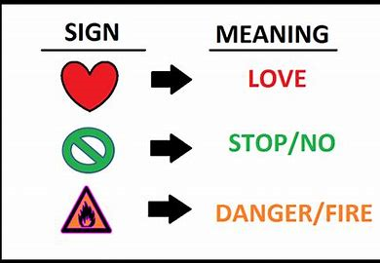
Semantic skills
Semantics is concerned with the meaning of language – single words and sentences. Our single word vocabulary is stored within the semantic memory – ready for us to choose the words we need every time we use them in sentences. The semantic memory is structured and highly organised so we are able to find the words we need quickly.
Words are stored by their meaning in association with other words. The basic word associations we develop are:
Function – what we do with it? What do we use it for?
Location – where do we find it?
Parts – what parts does it have?
Category name – which category/family of words does it belong to?
Attributes – i.e. colour, shape, size, texture
Feelings/personal experience
Associated words – i.e. synonyms/antonyms
People – who do we associate it with?
Time – when?

Slide 10
Semantic skills
Word concepts are developed through meaningful use in real life situations.
As a child learns a new word they will begin to generate a meaning for it based on personal experiences and knowledge of other words. We continue to redefine our word knowledge across situations and through our experiences.
Concrete vocabulary (i.e. nouns and verbs) are easier to develop as they are things we can see/touch/do
Abstract concepts such as concepts related to space, time, quantity, size are more difficult to develop as all of these concepts can be applied to a number of objects/contexts.
Not all children are able to automatically make links between words and word meanings. They do not organise their semantic memory in a structured way and therefore find it difficult to retrieve the words they need.

Slide 11

Things to look out for:
Word retrieval difficulties - uses a word that is similar in meaning to the target word or a word that sounds similar to the target word
Empty words – use of non-specific words such as ‘thing’, ‘that’, ‘it’ , ‘there’
Highly inventive words – when unable to retrieve a word makes a word up
Perseveration – gets stuck on one word and uses it repeatedly
Circumlocution – cannot retrieve the word so talks around it and describes it
GAP verbs – General All Purpose verbs, such as ‘make’ ‘do’ ‘put’

Slide 12
General strategies to support vocabulary learning
Make learning new vocabulary meaningful – create learning opportunities that hold meaning for pupils. It is easier to learn new vocabulary in the context of related, concrete and practical activities
Language through colour – visual supports, semantic links and categories are explicit, clearer understanding of what words mean and how they relate to each other
Develop knowledge, not just labels – semantic activities should be based on learning the meaning of words, naming alone will not be of any benefit
Give time to speak/think – 10 second rule, word retrieval difficulties increase when under pressure
Encourage circumlocution – encourage pupils to tell you about the word. Pupils will be using a strategy to help facilitate word retrieval.
Notes:
Long-term memory is based on visuals, not words, so enrichment activities should always include visuals
* Research indicates that vocabulary/words are usually only learned after they appear several times and it may take as many as 17 exposures for a CYP to learn a new word. It's also been found that the exposures are more effective if over an extended period of time. (So, pre-teaching allows more exposures and also, if that word detective card is displayed/kept and shown frequently over a two week period this helps to consolidate it in long-term memory.)

Slide 13
Specific strategies for Pre-teaching new vocabulary

Slide 14

IDEAS TO SUPPORT TEACHING VOCABULARY
The best way to pre-teach vocabulary words is to allow children or young people to have repeated exposures to the new vocab words.
There are several ways to do this: pronouncing the new word, giving the meaning, discussing the words parts, writing the word on the board, and using the word in a sentence or question. The latter enabling pupils to learn that some words have multiple meanings and therefore the context of the sentence/text can be different.
Notes:
Long-term memory is based on visuals, not words, so enrichment activities should always include visuals
* Research indicates that vocabulary/words are usually only learned after they appear several times and it may take as many as 17 exposures for a CYP to learn a new word. It's also been found that the exposures are more effective if over an extended period of time. (So, pre-teaching allows more exposures and also, if that word detective card is displayed/kept and shown frequently over a two week period this helps to consolidate it in long-term memory.)

Slide 15

WHICH WORDS DO I USE?
Choose a range of words from the topic, or curriculum subject.
These should be a range of nouns, verbs and adjectives.
Words can be looked at in three tiers – (Beck, McKeown and Kucan, 2013 – from ELKLAN Language Builders)
CORE
DESCRIBING
SPECIALISED

Slide 16
TYPES OF WORDS
CORE | DESCRIBING | SPECIALISED
High frequency. Objects. Rarely taught at secondary level. | Abstract words. Cross curricular. Often descriptive – adjectives, adverbs, vocabulary of time. Can usually be explained using easier and more familiar words. | Low frequency. Topic specific vocabulary.
flower Water Sun Grow soil | Sufficient Usually Centre Vertical spread | Photosynthesis Chlorophyll Pollination dispersion
Beck, McKeown and Kucan (2013)

Slide 17
Star approach
A systematic way of developing pupils’ vocabulary skills.
Words are divided into three groups:
Anchor words – everyday child words
Goldilocks words – not too easy and not too hard but just right/ everyday adult words
Step on words – topic specific/not everyday adult words
S select pick the most relevant words to teach
T teach introduce ‘Goldilocks’ words to the whole class
A activity help pupils remember and understand the word
R review transfer the word to the pupil’s long term memory

Slide 18
Example planning
Anchor words | Goldilocks words | Step on words
Everyday language for a pupil in your class | Everyday language for an average adult | Not used in everyday adult language and/or particularly topic specific
Worm Snail Fly Flower Plant Fruit Bird Animal Rabbit Hedgehog Under Grow Weather Babies Grass Tree | Dandelion Oak tree Adults young Shoot Within Produce Reproduce Survive Climate Soil Temperature Insects | Habitat Food chain Migration Hibernation Nocturnal

Slide 19
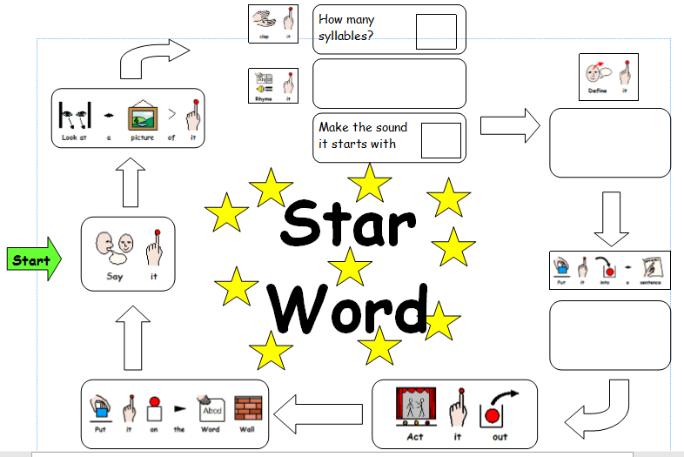
Notes:
The Jaw drop technique is considered more accurate than counting/clapping syllables.

Slide 20
Top Tips
It is important pupils hear the new words many times to help them remember how it sounds
Use the word in context to give clues about its meaning
Review and revisit to ensure the word stays in pupils’ long term memories
Send the words home for pupils to practise
Revisit words throughout the topic/term – put them in a pot, pull one out and ask pupils to think up a sentence using the target word.
Notes:
Long-term memory is based on visuals, not words, so enrichment activities should always include visuals
* Research indicates that vocabulary/words are usually only learned after they appear several times and it may take as many as 17 exposures for a CYP to learn a new word. It's also been found that the exposures are more effective if over an extended period of time. (So, pre-teaching allows more exposures and also, if that word detective card is displayed/kept and shown frequently over a two week period this helps to consolidate it in long-term memory.)

Slide 21
Pre-teaching vocabulary prompts
Symbols can be used to encourage children to think about the different features of a word, tapping into their semantic, phonological and perceptual word knowledge.
This pre-teaching strategy incorporates the following areas:
Word knowledge
Phonological awareness
Kinesthetic / visualisation
Reference: St John, P (2016) Pre-Teaching Vocabulary: Using visual prompts to teach independent word learning in children, What Works Edition, www.pipstjohn.co.uk
Questions to ask:
What does the word mean? Tell me about it. Describe it. What do we do with it? What parts? Where do we find it? What category? What do you already know? What does it link with? What is the root word? Can you use a suffix or a prefix? Can you find a word with the same meaning? Can you find a word with the opposite meaning? What does the word sound like? How many beats does it have? What does it rhyme with? What sound does it begin with? Is it a short, medium or long word?
Can you do an action? What does it look like? Can you draw a picture? Can you picture it in your head? Can you put the word in a sentence?
Notes:
Green = word knowledge (what it means) and red = phonological knowledge (what is said) purple = what do we do/see?

Slide 22
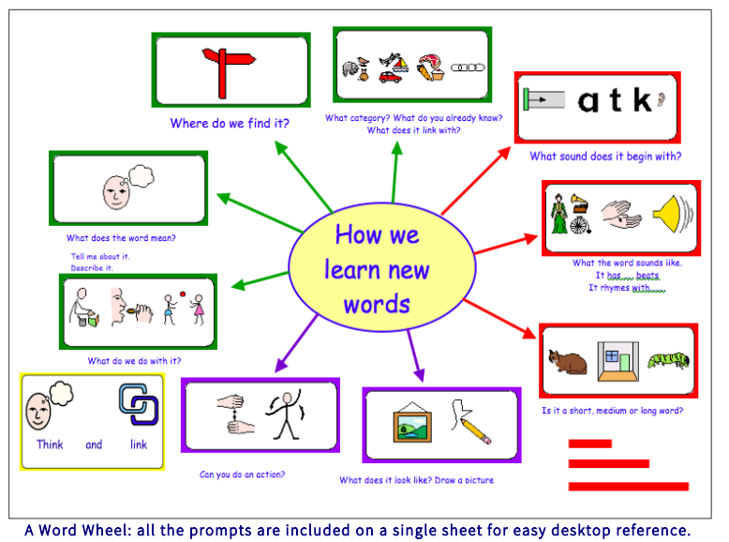

Slide 23
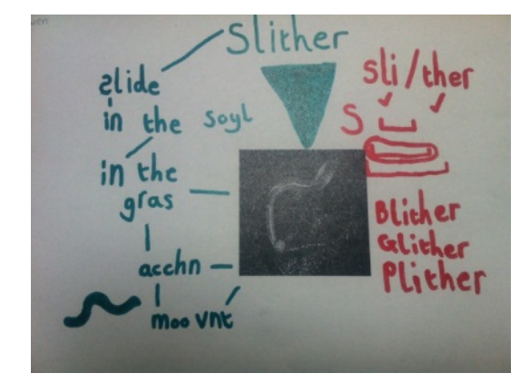
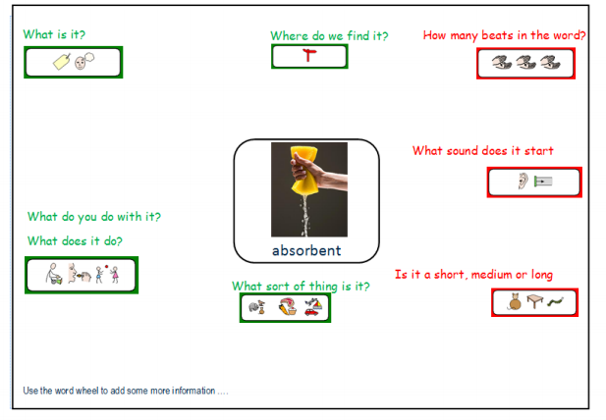
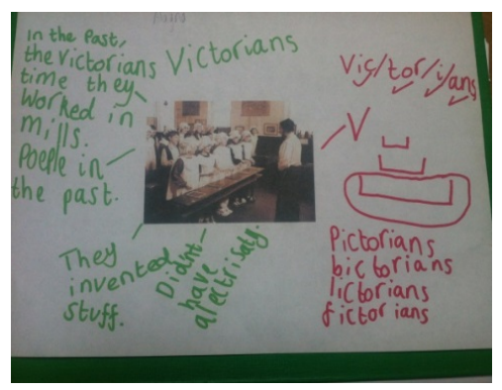
Word Knowledge Maps
St John, P (2016) Pre-Teaching Vocabulary: Using visual prompts to teach independent word learning in children, What Works Edition, www.pipstjohn.co.uk
Notes:
Green = word knowledge (what it means) and red = phonological knowledge (what is said)

Slide 24


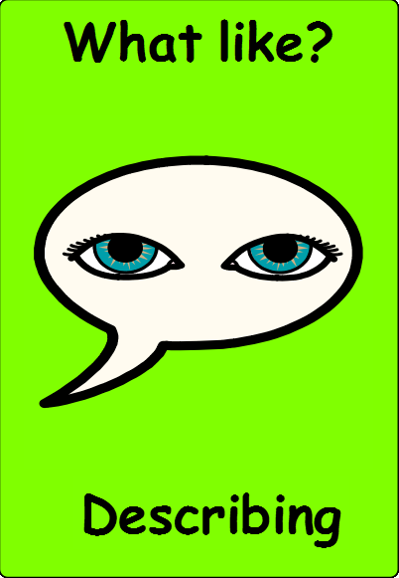
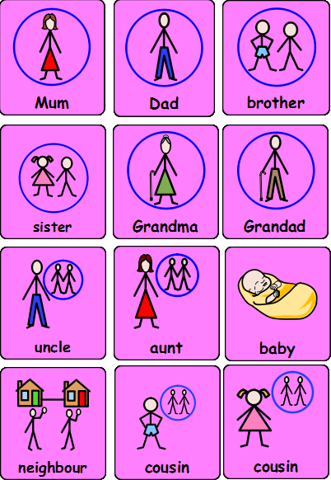
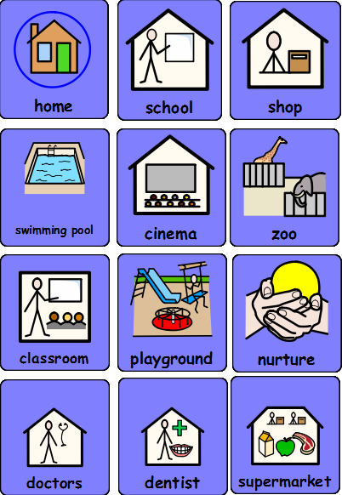
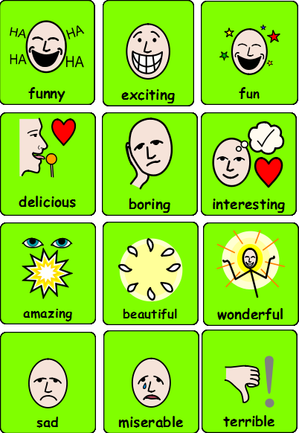
Semantic word books & visual dictionaries
These are arranged through meaning in categories (e.g. LTC) rather than alphabetically.
This helps pupils to see how words are linked together by association. Each time it is used the pupil considers what the word means and is reminded of other words related to it. This strategy supports the development of word storage and retrieval skills.
Could create personal ones for individual key pupils, or whole class visual dictionary which can be referred back to.

Slide 25
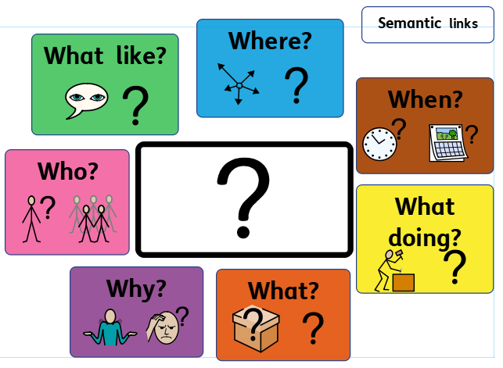
Word definition boards and activities
Use Language Through Colour as a visual support for word categories and definition activities.
Where do you find it?
What does it look like?
Word
What does it do?
Who uses it? Who does it belong to?

Slide 26
Word definition activities
Word of the week
Whole class – attach a picture representing the word of the week in the middle on a large class board. At appropriate times of the day (e.g. lining up for PE) discuss the word questions e.g. who can tell me what it looks like? Extend to children asking the questions.
What is it?
Group game – show a range of picture cards to the group and discuss each one briefly. Shuffle them, pupil chooses a picture and other pupils must ask questions from the board to try and guess what it is.

Slide 27
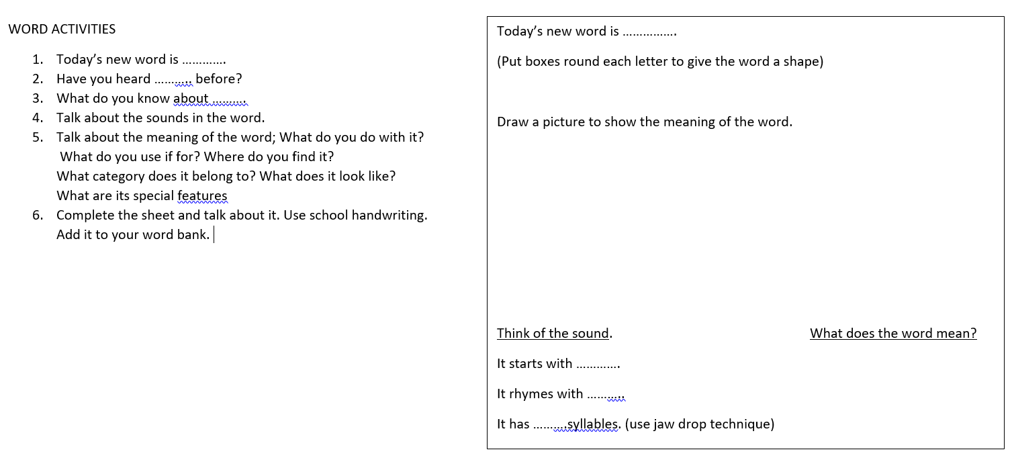

WORD DETECTIVES

Slide 28
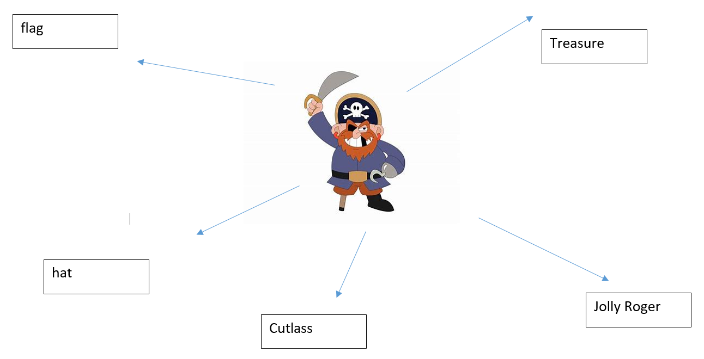
ATTRIBUTE WEBs
Mammal
Eats leaves
Animal
Has a long neck
Africa
In a zoo

Slide 29
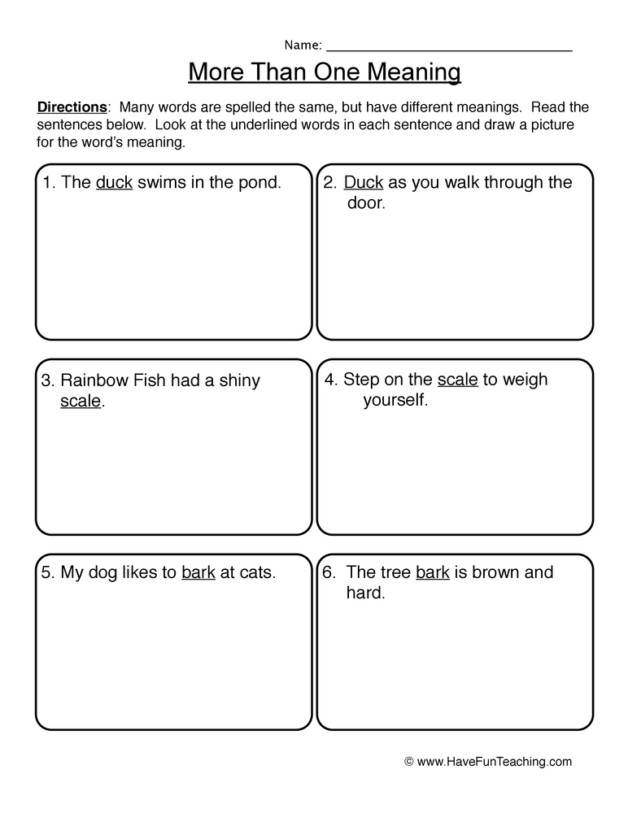
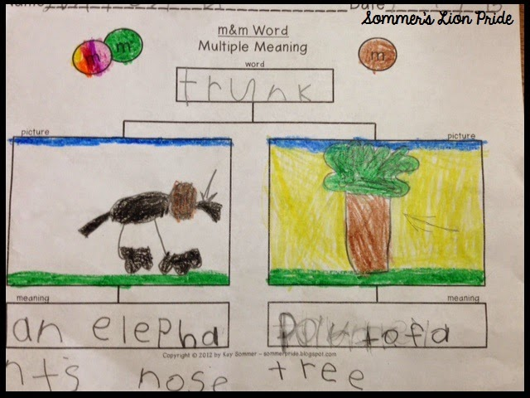
MULTIPLE MEANING TREE

Slide 30
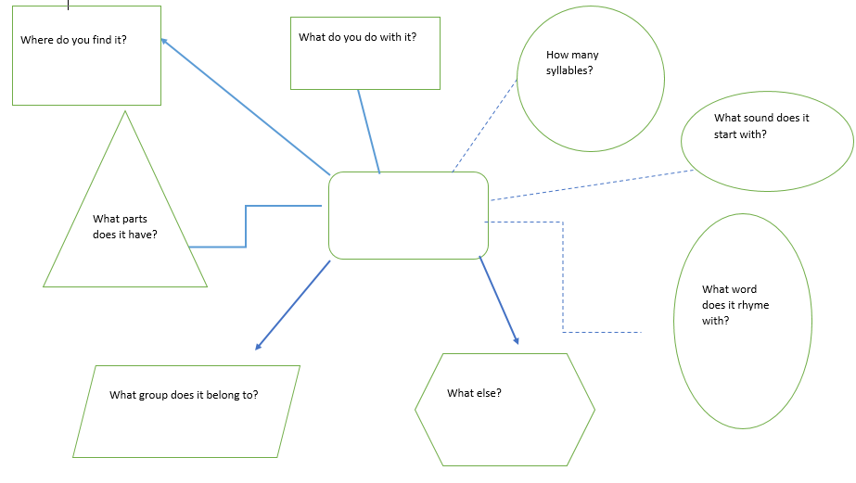
WORD MAP

Slide 31
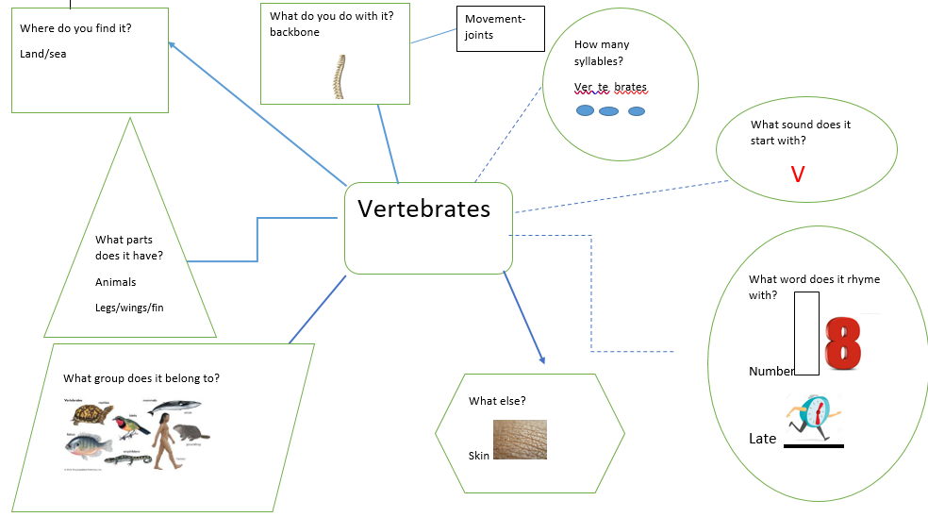

Slide 32
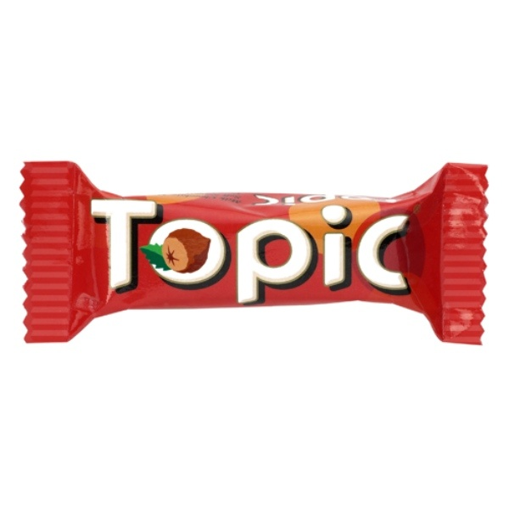
IDEAS TO PRE-TEACH TOPIC WORK
The topic should be explored with the child or young person in a multi-sensory way.
Use pictures, videos, role play and/or picture books. Allowing children and young people to access the topic using all their senses. This will also support memory and recall.
Creating scrap books on different topics using key vocabulary.
Audio albums – collect pictures of different aspects of the topic and record explanations. These can be taken back into class and provide reminders.

Slide 33
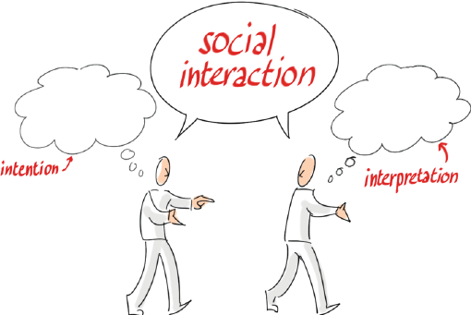
IDEAS TO PRE-TEACH SOCIAL UNDERSTANDING
Turn taking can be specifically taught through a board game and then these skills can be transferred to turn taking with playground equipment and then can be reinforced in the classroom too.
Games are a good way to teach a child about ‘losing’, waiting a turn, anticipation of their turn and the emotions involved in playing a game. The game rules should be mastered before expecting a child or young person to play with a peer.
Comic strip conversations can teach the view point of others. Friends can be interviewed by an adult to ascertain their feelings.
Social stories are good for pre teaching before entering a social situation.
It is really important that the staff all use the same language and vocabulary that a child understands.

Slide 34

RESTORATIVE THEORY
Restorative theory can also be used in circle time to pre teach social dilemmas. This method can also be used to pre teach the expectation of class conduct. Some class rules contain the phrase 'Be kind'....... but what does that actually mean?​

Slide 35
FURTHER READING
http://www.thecommunicationtrust.org.uk/
St John, P (2016) Pre-Teaching Vocabulary: Using visual prompts to teach independent word learning in children, What Works Edition, www.pipstjohn.co.uk
Beck, I.L. McKeown, M.G. & Kucan. L. (2002) Bringing words to life: Robust Vocabulary Instruction. New York: Guilford Press.
Parsons, S. & Branagan, A. (2014) Word Aware: teaching vocabulary across the day, across the curriculum.
Speechmark. Parsons, S. & Branagan, A. (2016) Word Aware 2: teaching vocabulary in the early years. Speechmark.

Slide 36
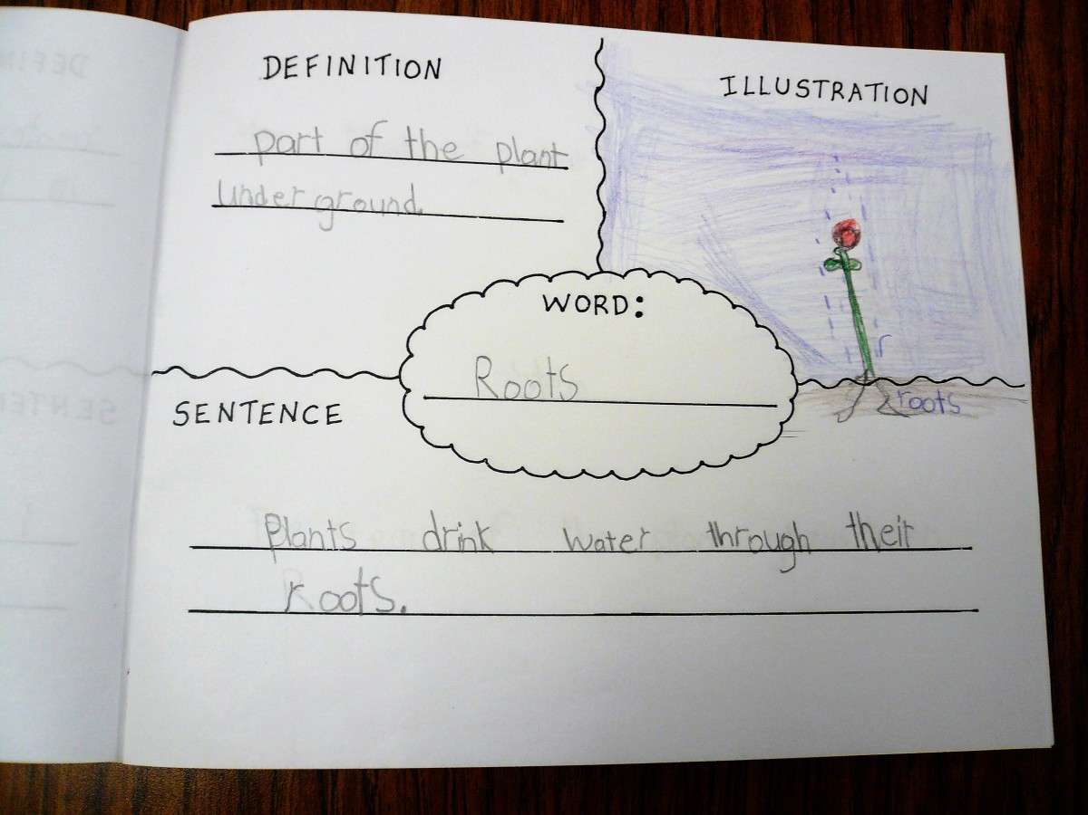
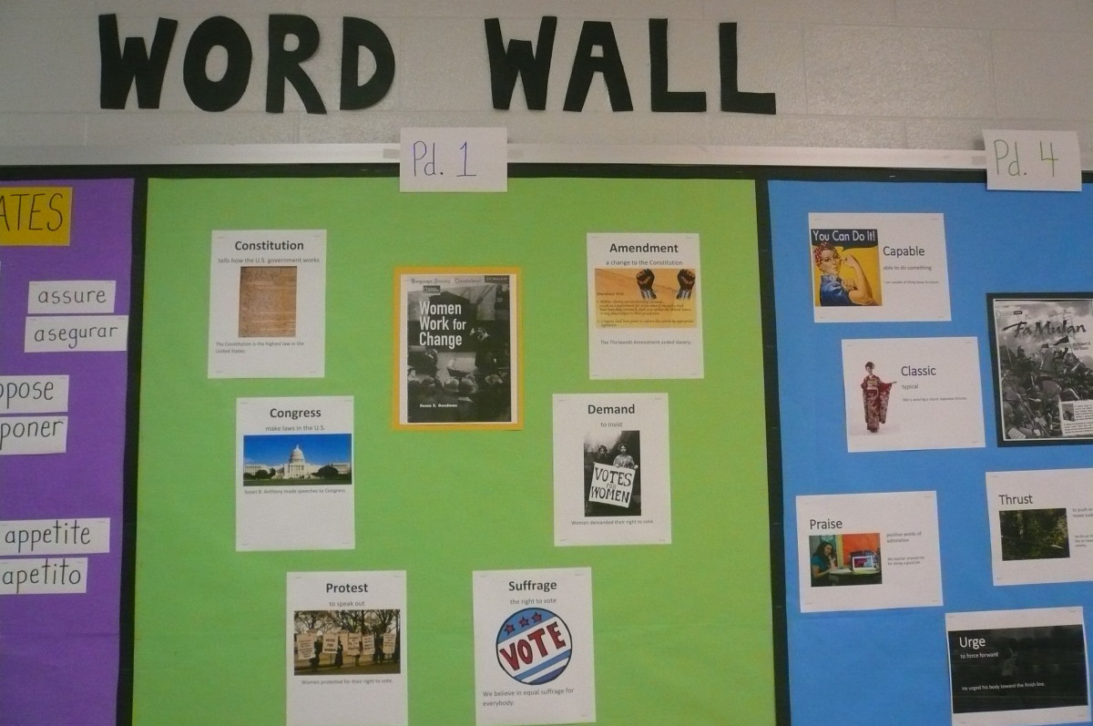
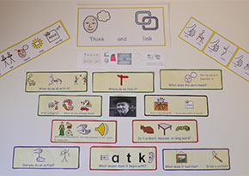
Any questions?
Please feel free to get in touch!
sarah.b@st-Nicholas.kent.sch.uk

