Slide 1
STLS Physical Disability
An introduction to our service- pertinent to nurseries.
Notes:
Hello everyone. Your Early Years Teacher have asked me to present some information about the PD specialist teaching and learning service.

Slide 2
Who are PD STLS?
We are a team of 7 Specialist Teachers (full and part time) who support CYP in mainstream settings and schools across Kent to be able to access the curriculum and site/facilities when they have a physical disability & or complex medical need.
Recent move to KCC.
We work alongside colleagues from health and education in ensuring the child’s needs are met, and that setting/school is happy and confident in meeting their needs.
Notes:
So, we are 7 specialist teachers who support children and young people in mainstream settings and schools across Kent; so roughly 0-19 years old. Our role is incredibly diverse- one day we could be on site at a school discussing building adaptations, another day we could be requesting a school puts in specific software for a child that finds writing difficult in exams and on another day- we are out at your nurseries! Our role starts where the Physical Disability or Complex Medical Need is so significant; that is outside the scope of the Early Years Specialist Teacher’s work.
So, in January 2023 we were tuped back to KCC. Before that, some of you may know that KCC commissioned Valence school (the only PD specialist school in Kent) to manage us and the Sensory team.
A big part of our role is to liaise with our health colleagues. We don’t have automatic access to health records; so like you need to ask for parental consent for paperwork to be shared. It is important that you are aware that we are teachers, not health professionals- so our work is about how to interpret the information you will gather so that the child can be welcomed to the setting safely and any health goals be included into their play or routine.

Slide 3
How do you refer to PD STLS?
Google ‘Kelsi and PD STLS’ to be taken to our landing page.
Notes:
Easier than a long webpage to find..

Slide 4
Notes:
So, our referral request form is on our landing page and these are for children that very clearly meet our threshold for example where a Physiotherapist has prescribed a standing frame to use in your setting or and Occupational Therapist has prescribed specialist seating to be used in your setting. Those types of equipment our funded by SEN, approved by PD STLS and we oversee –alongside health- that you are using these safely.
For all other enquiries, it is recommended that you book onto a PD Surgery which will have 2 teachers present for 30 minutes in order to give you advice about meeting the needs of a child with complex medical or complex physical needs. We will still look at referrals via LIFT, but it is much more helpful to have a direct conversation at PD Surgery. Should you just want an anonymous convesrsation; you are welcome to email me directly to arrange a phone call but no records will be written.

Slide 5
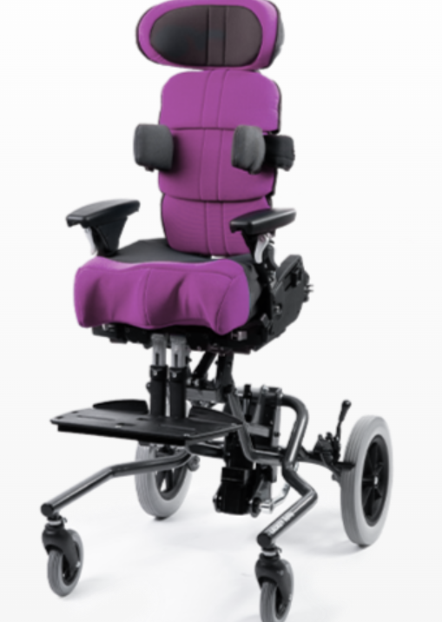
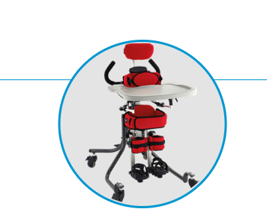
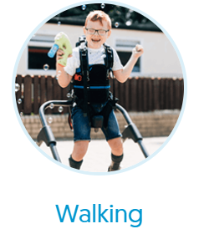
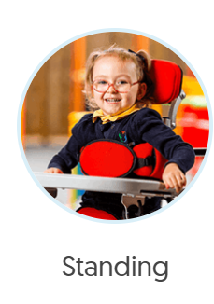
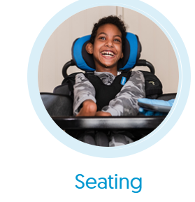
Notes:
So, this slide is just to demonstrate the three types of equipment that are often prescribed by our therapists. On the left we have, specialist seating and you can see that the child there needs a lot of postural support- what we call thoracic support at the chest and possibly even has support around his head. We then have the middle child. Not the best picture, but the girl is actually standing. These are fabulous at nursery because they enable the child to be at eye level with their friends. Often, for children with disabilities, the play needs to be brought to them and you can see that the chair and standing frame often comes with a tray- so rather than working at a tuff tray- we have to be creative and almost use a tray on a tray – such as messy play that their friend can use too! Finally, we have a walking frame on the right and again, he has quite a lot of support-looks like a saddle. Just a word of caution, usually a walker is the only equipment that can be used outdoors- unless of course there was a fire/emergency! So, there are thousands of different types of equipment (these are Leckey) but this gives you an idea of the complexity of children we work with for physical disability. (At this age, children usually have a buggy rather than wheelchair). Attend our M and H training to understand more about your responsibilities regarding checking the equipment, keeping your backs safe and how to work with therapists on a Moving and Handling Risk Assessment

Slide 6
Examples of conditions we typically discuss at PD surgery & may then take onto caseload
Neurological impairment, e.g. cerebral palsy
‘Muscle wastage’ conditions, e.g. Duchenne Muscular Dystrophy, SMA
Achondroplasia
OI
Upper and lower limb differences
Chromosomal disorders affecting physical development (impacting mobility significantly)
Acquired brain injury- stroke.
Complex medical needs, e.g. cancer, uncontrolled epilepsy/diabetes, chronic illness, cystic fibrosis. WE CAN SIGNPOST YOU TO THE APPROPRIATE NURSE.
No diagnosis but significantly delayed with mobility and not making progress; suggestive of an underlying disability
Notes:
Here is a list of common conditions we give advice about. Cp is the most common disability but a disability that presents very differently- I’ll come onto next. We also work with muscle wastage conditions (defo on caseload) – Duchennes is a deteritarting or sometimes called degenerative condition and is life limiting. It usually affects boys who typically become wheelchair users by secondary school and may live to around 20. There are other types of muscular dystrophies and all of them may not have a diagnosis til primary school unless they have a sibling with the condition. You may notice a child that is falling over and cannot go from sitting to standing without walking up their legs- but typically- skills are progressing/maintaining before 5 so we would take these children onto caseload in anticipation of work building up at junior age. SMA is a similar condition affecting boys and girls. SMA type 1 (the most sever type) often resulted in children not living past the age of 1, but if found early; there are now very recent drugs that means these children are in our primary schools (albeit with profound disability because of the damage before drugs)- without necessarily a SEN/learning need. Achondroplasia- sometimes known as dwarfism- we would give advice at transition point because these children often need adapted furniture/toilets/smaller sports equipment etc as they go into school. (surgery later possibly, wheelchair users) OI…yes
We would also give advice to children that have a missing limb/limb shortness – i.e. adapting activities. May/may not have a prosphesis.
We then come to chromosomal conditions which with the advance in genetics, are being diagnosed more and more.
The caveat about those cases is that we specifically give advice on physical access and how the child presents. If the diagnosis is ‘Global developmental Delay’ i.e. a delay in all areas- we typically find that physical development progresses such that we may give advice and suggest a watch and wait approach in case an underlying disability emerges. Dsyn common cases..defo come to surgery because of health implications. PD typically develops.
ABI-this is usually because of a bleed to the brain such as a stoke Presents the same as CP but CP is caused around the time of birth or in pregnancy.
Now, we come to complex medical needs. Typically, we can signpost you to the most appropr nurse and our role as teachers would be to ensure you have the correct paperwork in place, day 1 of the child starting. Sometimes we take on for a short piece of work.
Finally, common to have no diagnosis at this age..

Slide 7
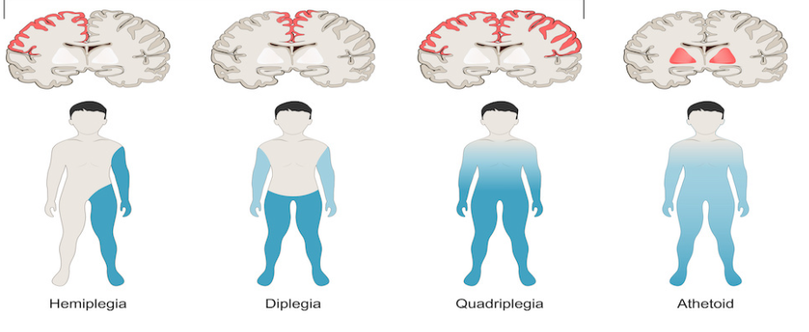
Cerebral Palsy
Notes:
Just a quick note on CP, because it is the most common disability (stroke). You can see from these images, that depending on where the brain damage has occurred and how much of the brain will directly impact which muscles are impacted. Hemi- one side. Diplegia-mainly bottom half. Quad/Athetoid- many of the muscles impacted from digestion, speech etc. Learning may or may not be impacted. We will support where equipment has been prescribed. Sometimes, we offer an investigative visit after our PD Surgery too.

Slide 8
Mainstream or Specialist? EHCp?
Notes:
Common question. Most children’s needs can be met in a mainstream placement, especially in the Early Years. Most children do not require an EHCp- often need a comprehensive IHCP or PDMP. Most schools and settings can be adapted to some extent to meet the needs of a child with accessibility needs, toileting needs etc. However, because the children on our caselist are so complex- there inevitably will be a proportion where an EHCp is appropriate and possibly specialist provision too. Currently EHCps in Kent are NOT linked to high needs funding although there is a consultation around funding currently. You will likely know that schools need to use their notional SEN budget before requesting additional funding and that schools should be implementing the mainstream core standards as universal good practice. There are no special schools except 1 in Sevenoaks, where PD is the primary need. Typically, at this age to be considering specilaist; there would need to be a very significant delay in learning and we would probably be discussing SNI placements to observe/assess.

Slide 9
Reasonable Adjustments
Adapting food policy for child with CF so they can have extra fatty foods.
Adapting the uniform policy for a child that bottom shuffles outside
Going to an alternative educational visit as the castle isn’t accessible that meets the same learning objective.
Sourcing a wheelchair friendly taxi for the school trip for the pupil and friends to use
Finding storage for the stander at school
Notes:
…….common parent worries. Please reassure them and direct them to the MSC standards

Slide 10
Common advice we give..
Research the condition. Ask for paperwork. Who is involved?
What universal / best practice guidance strategies for physical development have you already put in place? Is there progress?
How can you develop physical development further?

Slide 11
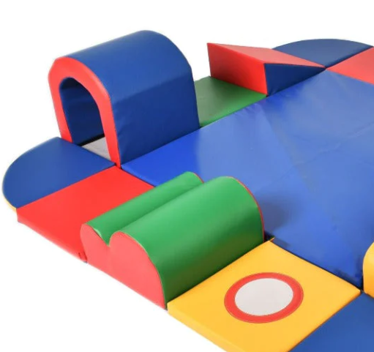
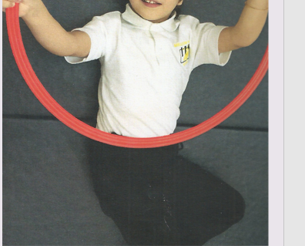
Gross Motor Rolling Sitting Standing Crawling Stepping
Notes:
In this picture you can see that the girl on the left has just kicked the ball down the slope. She is playing skittles against her friend to her left who is waiting for her turn. This is facilitated play – she is learning more about how to control her body, turn taking, cause and effect in a way that should couldn’t experience without facilitation . The second photo is of a boy who is holding a hoop which he can only achieve when he is lying down on his back as he does not have hand and arm control against gravity. Both of these children have cerebral palsy – but are relatively cognitively able so mainstream was appropriate.
Children with physical delay or disability all benefit from having the earliest stages of physical development specifically taught. It is about knowing and understanding the stages of progress – how we achieve that depends very much on what it is that is affecting their development. Our advice at PD surgery is often around

Slide 12
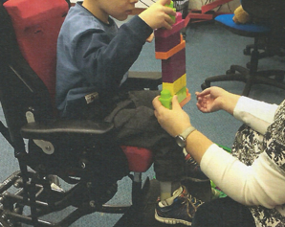
Fine motor
Reaching
Handling objects
Hold and release
Feeding self
Manipulating objects
Notes:
The boy on the left is able to grasp a beater – he wanted to play the ukulele but he could not strum it because of the fluctuating tone in his arm which meant he had very limited control over where his arm went. He is being facilitated hand under hand to hit the strings on the ukulele – not quite what he wanted but he was able to use the instrument to create a sound. He understood that he needed to be helped to use his hand to create this sound.
The boy on the right cannot stand independently, he cannot high kneel or crawl – however he can bottom shuffle and get around very quickly by doing this. He was able to build a tall tower with facilitation to provide a secure base and to pass the bricks to him. He is achieving success in terms of building bricks – this is far above and beyond putting three bricks into a tower which is a Portage stage of achievement, but he couldn’t do this without facilitation. He is able to build on successes

Slide 13
Bringing the world to the child
Notes:
This is a child with PMLD – she benefits from multi-sensory learning where the world is brought to her, she has lots of time to explore and begin to understand the world. This includes exploring her body with time on the floor to move freely, respond to music, have sensory experiences like TAC PAC and experiment with independent movement. She was able to sit independently, to roll and to stand with facilitation – she will not be able to walk independently because of her muscle tone and inability to coordinate her movement

Slide 14
Meet the child where they are at! GMS
Babies- Lie on back (supine position), Turn from side to back, Will lift head briefly in prone position (tummy time), Jerky arms and legs, if pulled to sitting (head lag).
Three months-stronger head in prone and in supine. Kick legs vigorously
6 months-can roll over from their back, move their arms more purposefully
9 months-maintain sitting with straight back (unsupported 15 mins). Pull to stand.
12 months-Sit to stand. Stand alone for a few moments, cruise along furniture, walk alone-feet wide/hand held. Falling over
15 months- kneel without support, walk alone.
Notes:
Read out. Stop the slideshow here. What activities could you do with a child if they are physically at one of these stages? Pause 5 mins.

Slide 15
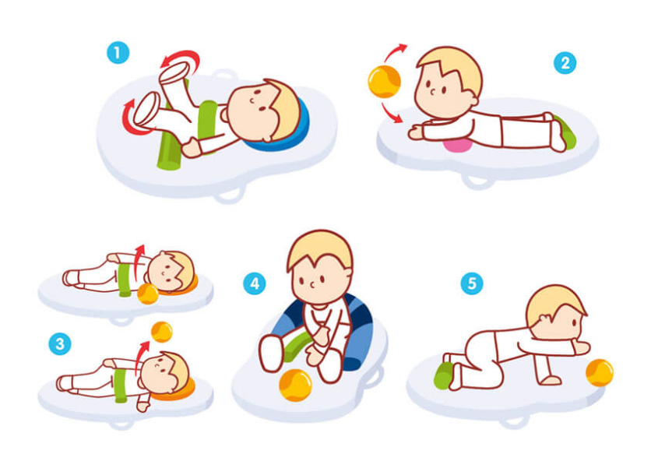

Slide 16
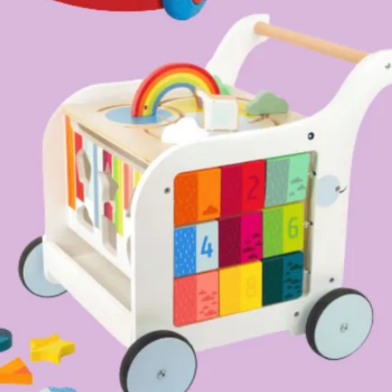
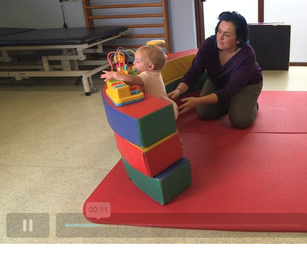
How to encourage standing/side stepping?

Slide 17
https://www.kentcht.nhs.uk/childrens-therapies-the-pod/physiotherapy/under-2s-development/
https://www.kentcht.nhs.uk/download/toy-and-play-information/

Slide 18
Meet the child where they are at FMS
Babies-open hand to grasp adult’s finger.
3 months- clasp and unclasp hand at the midline, briefly hold a rattle
6 months- use whole hand (palmar grasp a toy from one hand to the other)
9 months-manipulate toys. Pincer grip. Can’t put down voluntarily.
12 months- pick small objects up. Point with index finger. Turn pages in book, hold crayon in palmar grasp, drop toys purposefully.
15 months- Build a tower (2 cubes)to and fro scribble.
Notes:
5 minute pause. What might you do?

Slide 19
Crossing the midline
Place toys slightly out of reach
Place them on opposite side
Bilateral activities
Notes:
Crossing midline is the ability to move ones hands, feet, and eyes not only together, but across and to the other side of the body.
Why is it important?
It is important for children to have the ability to reach the midline of the body with opposing arms and legs in order to perform tasks on the opposite side of the body. Another important reason to be able to cross midline is so that it allows the right and left side of the brain to communicate. Each side of the brain is used to carry out different tasks. Therefore, it is necessary for both the left and right side of the brain to work together in order to coordinate certain movements and improve effective learning.
How it can affect your child:
Crossing midline builds the foundation for appropriate development of various motor and cognitive skills. Many daily activities require the coordination that comes from cross lateral motions. Children who have difficulty crossing the body’s midline often have trouble with skills such as writing, reading, crawling, riding a bike, and many other schools/playtime activities.

Slide 20
Key training for settings
Moving and handling training
Individual programmes from physio
Individual programmes and advice from OT
Individual advice on feeding and drinking S&LT
https://www.kentcht.nhs.uk/service/childrens-therapies-2/schools-and-professionals-resources/
Individual advice on communication S&LT
Notes:
Moving and Handling training is currently offered through the SENIF core training offer to EY settings for two practitioners free of charge where funding is provided to meet a physical disability. For guidance – children over 15kg who are not weight bearing are deemed to be too heavy to be lifted by one person and a setting should seek advice.
Individual programmes are usually offered for children with the most complex needs – we can look a bit more at what this might include

Slide 21
IDDSI FRAMEWORK

Slide 22
Training
Care Plans & Risk Assessment in the Early Years- Next course is 19th March 1.30-3.30 online. Email pdteam@kent.gov.uk to book
Notes:
Here is a taster of CP/RA..

Slide 23
I’m worried about the child starting safely..
Enrolment form indicates a need.
Taster session with parents on site/Home visit. Evaluate.
Request copies of health information.
Research (NHS, Charity website).
Do I need to have a care planning meeting, so I can gather enough information from parents, paperwork, other professionals to draw up a PD Management Plan/IHCP, Risk Assessment and PEEP?
Do I need SENIF in advance of them starting? (PD Surgery minutes and/or Portage evidence can support this request)
Notes:
Evaluate- what could they access /not access. Settings do need to comply with the Equality Act which places an anticipatory duty on you to prepare for people with disabilities to access the site safely- it shouldn’t be that you wait for a taster session. None the less, a taster session, can throw up new things. We would like nurseries to have an Accessibility Plan that over the course of a given year, budgets for works to make settings more accessible e.g. removing concrete gardens, purchasing captain chairs, purchasing changing tables that have an up/down facility so that an older child doesn’t have to be changed on the floor because they cant mananage the steps on the changing table and the child is becoming too heavy to lift, smaller things- teddies/dolls with different medical equipment,
Request copies- It is imperative that you work with parents and that your care plans are evidence based. It will near impossible to assess risk; without the facts.

Slide 24
Care Plans, Risk Assessments, Intimate Care Plans & PEEPs
A brief introduction.

Slide 25
Individual Health Care Plans
These relate to the health needs of an individual student and should NOT be confused with an EHCP.
They should be written in conjunction with health professionals and parents.
If a health professional has written a Care Plan the setting should never then re-write this plan.

Slide 26
‘Supporting pupils at school with medical conditions’ (DfE dcoument) provides advice on when to draw up an individual healthcare plan. (This is not the same as an Education, Health and Care plan EHC)
A suggested format for an individual healthcare plan can be found on Kelsi:
https://www.kelsi.org.uk/early-years/equality-and-inclusion/including-all-children
The Health Conditions in School Alliance is made up of over 30 organisations, including charities, healthcare professionals and trade unions who work collaboratively to make sure children with health conditions get the care they need in school. They provide links to a range of charities and organisations.
http://medicalconditionsatschool.org.uk/
Check insurances!
Notes:
Care plans – are used to document the medical needs of a CYP, where an intervention needs to take place or medication needs to be administered in school.
You would also need to have a care plan if a child did not need an intervention in school, but had a condition which a paramedic would need to know about if there were a medical emergency for that child.
You would need to include the child’s personal details, emergency contact details, medications, diagnosis, consultants & which hospitals, what constitutes an emergency for that child and what procedures should be followed.

Slide 27
Risk Assessments
Risk assessments are used to identify and document strategies to minimise risks and hazards to a specific CYP or those working with them.
KCC 5 step approach on KELSI
https://www.kelsi.org.uk/policies-and-guidance/health-and-safety-guidance/risk-assessment
PE/Educational visits (higher risk) may require 1 specific
Moving and Handling Risk Assessment (attend course and draws on the Moving and Handling plan given by therapists)

Slide 28
PEEPS
Personal emergency evacuation plans
Any person (adult or child) who needs assistance to evacuate from the building will need a PEEP in place. (PD, VI, HI)
The CYP and staff need to have practiced evacuating following the PEEP. All staff should be aware of what it says.
It should be agreed and shared with your fire safety officer at your setting.

Slide 29
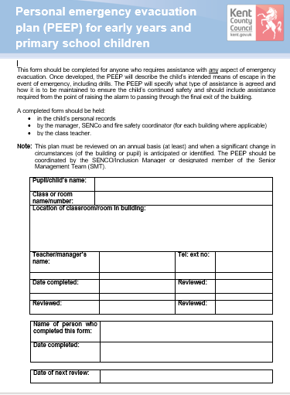
PEEP
This is a 7page document, but is not a complicated or onerous form to complete.
Please consider what to do if your school is on more one floor, & or the CYP can not evacuate themselves.
https://www.kelsi.org.uk/policies-and-guidance/health-and-safety-guidance/fire

Slide 30
Physical Disability Management Plan
Sleep
Feeding
Physio name and programme. Goals. How to incorporate into day? Equipment?
Toileting /Personal Care
Medications at home- side effects
Communication
Notes:
More of a holistic plan- usually where a child has equipment.

Slide 31
Contacts for Kentchft Trust
OT/physio/SALT (swallow vs.speech) – The pod! kentchft.cteast-admin@nhs.net
East Kent (Thanet and Canterbury) 0300 123 8112.. CARE CO-ORDINATOR MAY BE BEST FIRST POINT OF CONTACT IF THERE IS ONE.
HEN - Home Enteral Nutrition Service kentchft.hen@nhs.net
Bladder & Bowel Nursing Team -kcht.childrensbladderandbowel@nhs.net
Epilepsy Nurse – kcht.cen@nhs.net
Community nurse (cancer, CF, suctioning machine..etc)
London health teams often support too!
Notes:
-Not Swale (Different trust) or Folkestone (Ekhuft Trust). Referrals or to chase up where a child is in the system.
As a general rule of thumb, for children on our caselist, it would be where therapists see the child in setting (not just in clinic children). Often block on, block off.
HEN- gastro fed. They or Nutricia will give training.
BB e.g. catheterisation (not low level toileting-that would be via Health Visitor)
Ep nurse- care plan- emergency protocol training.
..and other contacts e.g. CF nurse/

Slide 32
PDNET
pdnet.org.uk
This is an online network for educationalists supporting children with PD.
https://pdnet.org.uk/pdnet-level-1-training/
https://pdnet.org.uk/self-evaluation-tool-2/
Notes:
Recommend level 1 training and self evaluation (auditing tool) and the forum to ask questions!

Slide 33
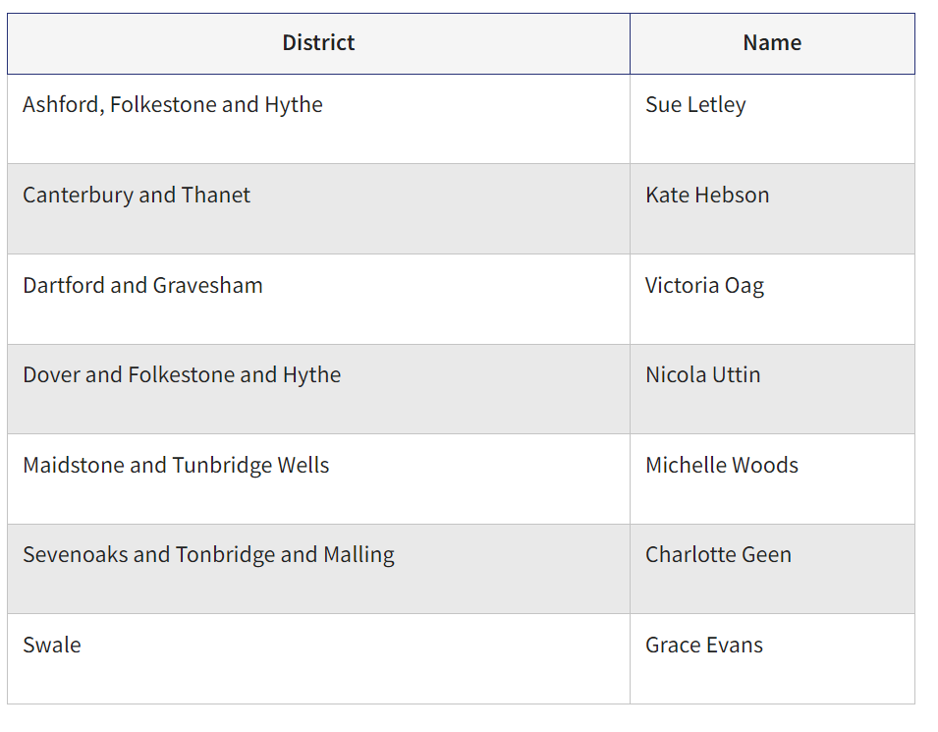
kate.hebson@kent.gov.uk- Canterbury Email pdteam@kent.gov.uk for training / referrals/contacts for other districts.

Slide 34
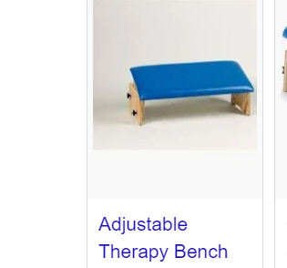
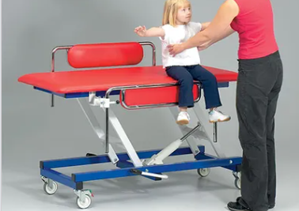
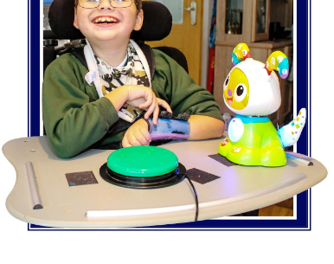
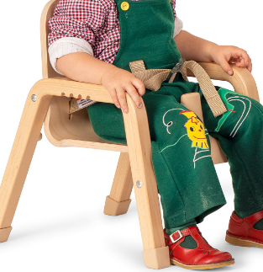
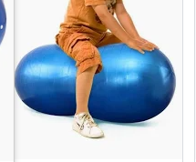
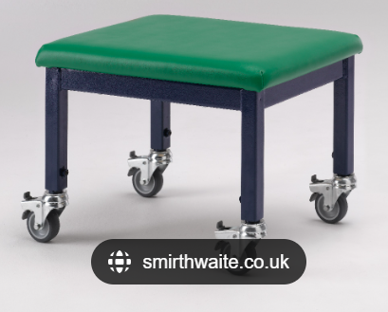
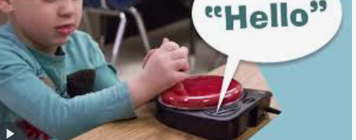
DAF
https://www.inclusive.com/uk/
Notes:
Any resources purchased as part of DAF remain the property of that particular provider. However, if a child is moving onto another provider, they may wish to make arrangements for the transfer of any resources. Beds- use all of 1 budget. Think about garden- false grass not ideal for pushing walkers.
MH- therapy stools. Hippichicks (but always advise not to lift). Therapy benches – practise side stepping. Penaut balls/therapy balls to practise reaching out of centre of gravity. Chiars with arms. Switch toys-for pre verbal children.

Slide 35
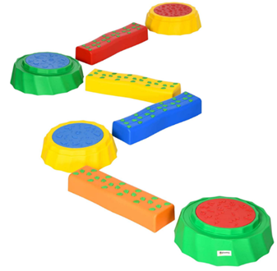
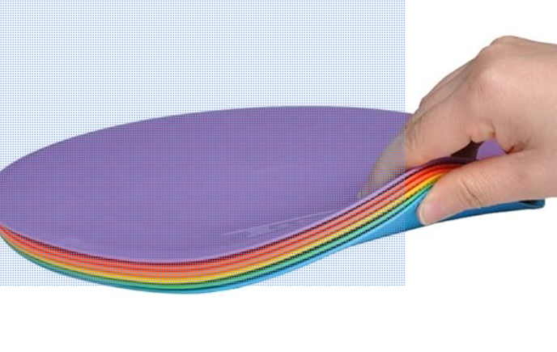
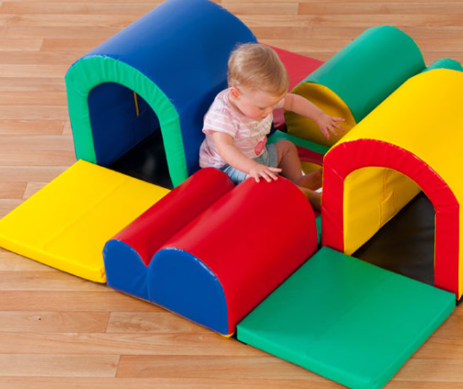
Notes:
Encouraging x to follow an obstacle course which involves her making small steps. This should be very simple to start with and could just be created with stepping stones which begin next to each other. Sequencing spots can be used to make the pathway for her and her peers to follow. Eco Walker 25cm (10inch) Spot Markers Flat Field Cones : Amazon.co.uk: Sports & Outdoors The challenge can be increased in a variety of ways including:
- moving the spots futher apart.
- giving a choice of direction
- giving instructions for which colour to go onto next.
- putting small toys on each spot so Freya can bend down to pick them up.
- Similarly, an obstacle course could be made which encourages Freya to make small steps up and down. This could be created using equipment you already have or resources such as these: Outsunny 8 PCS Kids Stepping Stones Balance Beam w/Non-Slip Surface and Bottom, Stackable Stepping Stones for Toddler : Amazon.co.uk: Toys & Games
This activity can be differentiated in the same way as mentioned above so that it can be accessed by all children.
Encourage tummy time for drawing and story time. Playing games that include moving to different levels and opportunities for crawling for example through tunnels.
When doing any kind of physical activity, give clear verbal reminders of where to look to increase spatial awareness. Staff may find it helpful to develop a script to be used, which can be added to her risk assessment.

Slide 36
Personalised Plans
Notes:
PD STLS will produce similar report style as EYST- which will include some outcomes/targets for you to transfer onto a PP. The PD target ideally maps with the Phsyio/Ot goals, so please have those ready at the initial visit! Please review your PP in the usual way before our next visit.

Slide 37
Thank you.
Any questions?
Notes:
Please compile questions to Sue/Ali- and I can send a group response.

