Slide 1
Anxiety
Emma Harrison Social, Emotional and Mental Health
Specialist Teaching and Learning Service.
Canterbury and Coastal District.

Slide 2
Helpful tips.
Pen and paper for note taking
As you listen, you can manually click on to the next slide
Please check your volume button
Further questions

Slide 3
Aims of this course
Causes and symptoms of anxiety
Your own self care
How anxious thoughts can overwhelm individuals and affect behaviour
Strategies to support children and young people

Slide 4
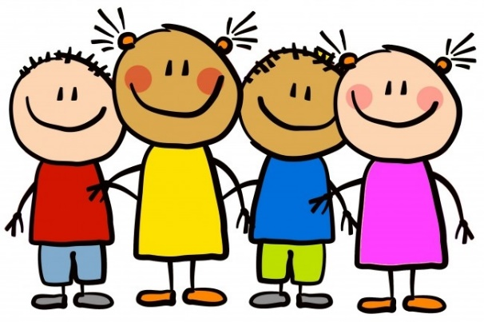
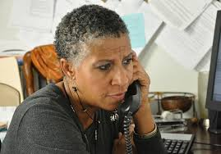
Causes of anxiety

Slide 5
There are different types and causes of anxiety for children and young people.
General anxiety
Fears
School related
Family problems
Divorce and separation
Death or illness of a parent or close relative
Discipline that is harsh, inconsistent or overprotective
Traumatic experiences

Slide 6
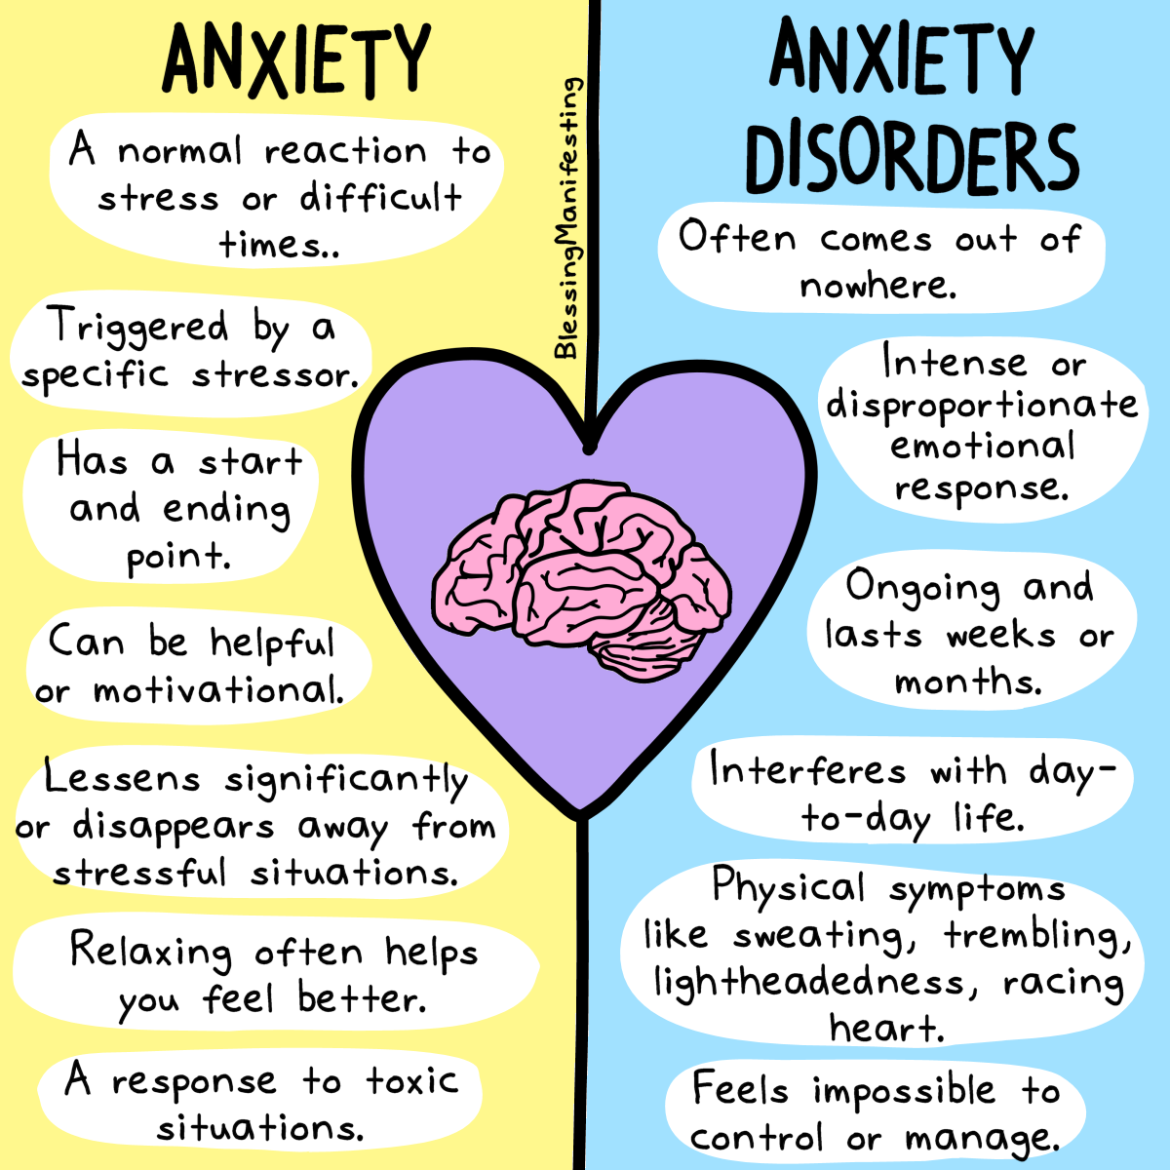

Slide 7
The symptoms of anxiety You might start out just feeling generally anxious, but if your symptoms get worse or last longer than they should, it could be time to get some support. Symptoms may include:
feeling nervous, on edge or panicky all the time
feeling overwhelmed or full of dread.
feeling out of control
having trouble sleeping
low appetite
finding it difficult to concentrate
feeling tired and grumpy
heart beating really fast, thinking you are going to have a heart attack
dry mouth
trembling
feeling faint
stomach cramps and/or diarrhoea. Needing to pee more than usual
sweating more than usual
wobbly legs
getting very hot

Slide 8
Points to consider as an adult
Positive relationships with pupils are key
It is ok to talk about feelings
Be clear about how pupils’ experiences and thoughts may resonate with you
Nurturing CYP is key, but it is important to build resilience, not to disempower the young person
The young person is not attention seeking. They are seeking guidance about self care and understanding their feelings and emotions
As an adult, you are teaching the pupil to manage their emotions. Not all pupils can be expected to pick themselves up and dust themselves off
Defend the well being curriculum
Small steps are powerful

Slide 9
You can’t teach someone to swim if they are drowning.

Slide 10
Trigger
I have forgotten my study book. I cannot revise for my test
Negative thoughts
I’m going to fail my test.
Feelings
I feel sad. I feel hopeless about the future

Slide 11
Thoughts influence feelings | I have forgotten my book. ‘’I’ll never succeed at anything.’’
Feelings influence actions | Put off studying. Becoming more discouraged.
Actions influence thoughts | ‘’I don’t know why I keep trying. I am a failure.’’

Slide 12
Strategies to support children and young people.
Make time to talk.
Engage the young person in a task and begin a casual conversation.
Get into a regular habit of talking about things generally.
Ask the CYP about how they are feeling and let them say what they want to say.
The more you listen and talk, the more the child will know that they can come and talk to you.
Plan coping strategies together
Learn from the things that go wrong.

Slide 13
Smile at people
Find a way to get the worries out
Find something to look forward to
What helps you to self soothe?
Understand that you are not alone
When you smile at people, they will smile back at you. This helps to connect with people in a positive way.
Keep a journal write, draw pictures or colour
Share your struggles with people you trust
Is there a time in the day that you enjoy?
What part of the week do you like?
Is there an event or celebration that you enjoy
Playing board game
Stop and focus on breathing.
Touch, taste, smell and music
Calming technique cards
Drink of water
Positive affirmation cards
Activity (6 ways to well being)
Books are available. Information on the internet.

Slide 14
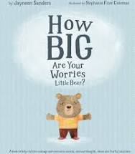
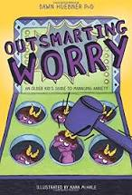
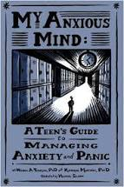
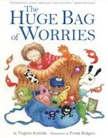
Resources to support your work
Incredible 5 point scale
Books
Boxall profile
On- line support
Outside agencies

Slide 15
emma.s@st-nicholas.kent.sch.uk

Slide 16
References:
On-line reference material:
Minds.actionfor children.org.uk
Youngminds.org.uk
Royal College of Psychiatrists. Mental Health and Growing Up.

