Slide 1
Active Listening
Katy Harrington
Specialist Teaching and Learning Service
Canterbury City and Coastal District

Slide 2
Aims of the session:
To understand what is meant by 'active listening' and why it is such an important skill.
To identify ways of supporting pupils to develop their active listening skills.

Slide 3
Aim One: To understand what is meant by 'active listening' and why it is such an important skill.

Slide 4
What do we mean by active listening?
Giving full attention to the speaker
Trying to understand the complete message they are trying to communicate
i.e. 'good quality listening'.

Slide 5
Signs of active listening include:
Smiling and nodding
Remembering
Asking questions
Positive reinforcement
Avoiding distractions, staying focused

Slide 6
Signs of difficulties with attention and listening include:
Easily distracted
Fidgeting
Struggles to follow instructions
Difficulty in completing tasks
Unsure how to start a task
Can distract others
Maybe passive and withdrawn

Slide 7
Why is active listening so important?
Enhanced learning and understanding: pupils are better able to retain information and are less likely to get distracted.
Helps pupils become better communicators and supports other crucial lifelong skills (e.g. Problem-solving; experience fewer misunderstandings etc.)

Slide 8
Why is active listening so important?
Listening should be an active process.
We want children to:
- listen intently
- rather than guess or opt out, acknowledge difficulties and seek clarification

Slide 9
Aim Two: To identify ways of supporting pupils to develop their active listening skills.

Slide 10
Be a good role model/set the example
Make sure you are an active listener!
- Give pupils your full attention
- Give pupils eye contact
- Do not interrupt them
- Ask them questions
- Repeat back important things they have said
i.e. be a genuine listener!

Slide 11
Time to talk
Have conversations about things your pupils are interested in.
Regular opportunities for children to chat with one another, to share ideas and experiences (e.g. weekend news)

Slide 12
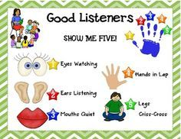
Teach the rules of active listening

Slide 13
Play Spot it!
Read a familiar story, but make silly mistakes e.g. give people the wrong name or include a nonsense word.
Ask the children to put their hands up or clap if they spot a mistake.
Teach the children to identify the problem e.g. to ask ‘what does bablab mean?’
Give constructive praise e.g. ‘Good listening! You spotted the mistake and asked me what the word was’.

Slide 14
Play Spot it!
Then use this activity in other situations e.g. when giving information, instructions or during a plenary session. (e.g. incomplete information; vocabulary that is too difficult etc.)
Warn them first though!
Once they can identify single problems warn them that you are going to use several types of ‘spot it' together e.g. some difficult words and some incomplete information.
You may need to teach the children phrases to use to identify the problem e.g. "please say that more slowly."

Slide 15
Listen for key information
When teaching, give pupils a piece of key information to listen for.
Additional support can be given e.g.
- prompts that the information is coming up (visually or verbally)
- checking that the message has been received

Slide 16
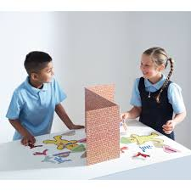
Barrier Games
These encourage the ‘listener’ to practise seeking support/clarification. Ideas:
Guess the shape/picture – child A describes shape/picture to child B who has to guess what it is (or draw it themselves).
Create a scene – each child has identical materials and background scenes. As child A sets up their scene, they describe in detail what they are doing, to child B who has to recreate the same scene.
Time lines - Each child has a timeline with something missing. They have to ask each other questions to find the missing information.

Slide 17
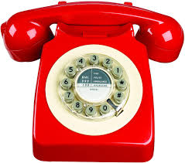
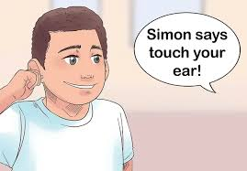
Group Active Listening activities
Simon Says
The Telephone Game
One person comes up with a sentence and whispers it to the next person in line. They have to listen then pass it on to the next person and so on until it reaches the last person who says it out loud.
Follow the Directions
Give pupils a piece of paper each. Read out a series of short, simple instructions. They have to draw the directions they hear.
Popcorn Storytelling
Build a story together. The first person begins e.g. "Once upon a time there was blue frog who lived in a shoe". The next person adds something new to the story, and so on until the story is complete.

Slide 18
Supporting asking for help
Create a safe classroom environment in which everyone feels able to ask for help.
- Explain that it is good to say when you do not understand something
- Asking relevant questions is viewed positively
- If necessary, teach what to do and what to say when information is not understood

Slide 19
Supporting asking for help
Initially prompts may be needed.
Monitor progress and ask "Do you want help?"
If "Yes", identify the issue and model what they should do and say.
E.g. "Katy, if you want help, put your hand up. When I come say "Ms Harrington, I can't remember what to do".
Gradually stop modelling the response. Just prompt e.g. "What do you say when you need help?"
Gradually phase out the verbal prompt. Stand there looking expectant and wait for the child to ask.

Slide 20
Supporting asking for help - things to think about:
Encourage pupils to identify and communicate the kind of help they need.
Be aware of children who do not know when they have not understood.
Be aware that this process can take a long time to achieve.
Ensure this skill is then reinforced in a variety of situations.

Slide 21
Supporting asking for help: a visual strategy
If a pupil is reluctant to ask for help verbally, consider using a visual help card.
Have card(s) easily available and visible on the pupil's desk.
If the pupil has indicated they need help by showing the red card, encourage them to the say what help they need.

Slide 22
Suggested activities for families:
Read stories: Ask them to predict what will happen next.
Cook together: Read the recipe to them. The child/young person has to listen to and follow each step to complete the recipe correctly.

Slide 23
And always remember to:
Reduce noise level and distractions.
Ensure that you have the young person’s attention before giving an instruction.
Use an appropriate level of language.
Support spoken language with visual cues wherever possible.
Check the information has been understood.
Praise and reinforce good listening.

Slide 24
Reference and for further information:
Language for Learning in the Primary School: Sue Hayden and Emma Jordan
Active Listening for Active Learning: Maggie Johnson & Carolyn PLayer (2009)
ELKAN training resources
Listening for Information Challenge Cards
Listen and Do Activity Pack
https://www.twinkl.co.uk/resource/t-t-2567035-make-a-story-storytelling-prompt-cards
Contact me if you have any questions:
Katy.h@st-nicholas.kent.sch.uk

