Slide 1
A ‘How to’ guide to creating and using visual supports in the Early Years
Canterbury STLS
Ali Goodsell & Sue Fisher

Slide 2
Why do we use visuals?
It helps us emphasis key words
It helps us slow down so children can process language
It helps our message last longer than just words
It gives a clear visual idea of what we are talking about
It helps children pay attention to us
It can be easier than forming words
It helps a child understand what is going to happen next
It helps a child understand routines and expectations

Slide 3
Basic Rules
Think of the child’s developmental level – a whole session or day timeline may not appropriate
What support does the child needs? - real objects, photos or symbols?
Have them in a place the child can see them clearly (Lanyards or key rings can be useful)
Introduce the pictures one at a time so the child understands what they are and make connections with their experiences
Be consistent
Visuals can be supported by signing to make the message even clearer

Slide 4
Supporting visuals with signing (Makaton)
Signing supports all children
Follows the normal grammar and syntax of speech
Gives a clear visual idea of what is being said
Generally used at a functional or key word level in Early years
Sign of the week - https://makaton.org/TMC/The_Makaton_community/Sign_of_the_Week.aspx
Free resources https://makaton.org/TMC/Free_resources_
Makaton taster sessions – STLS / Early Years

Slide 5
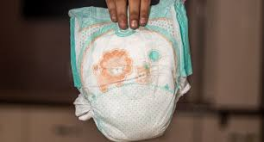
Real objects
When a child is at an early developmental stage using ‘real objects’ will help them make connections in their brains and ‘label’ items
Use a ‘Now’ and ‘Next’ approach – “Now nappy, then snack” (some children may need just ‘now)
Be at the child’s level so they can see the item clearly
Keep language short and simple

Slide 6
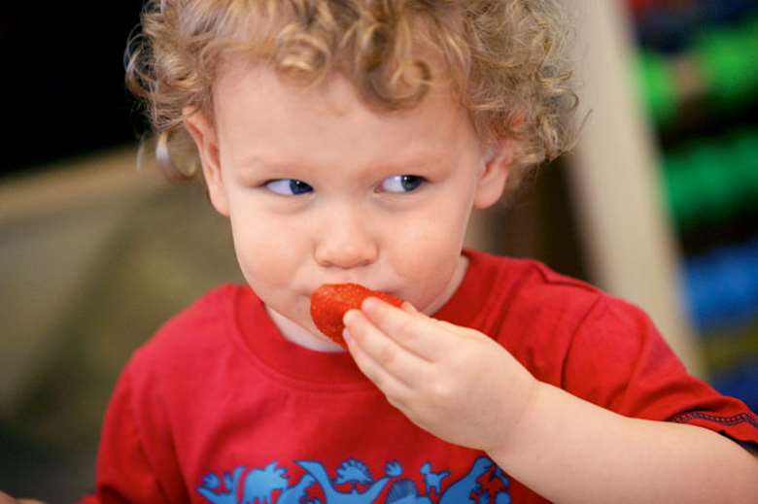
Moving from the ‘real’ to the ‘pictorial’
Use photos once a child understands what the objects are
Use clear pictures of the event or object (try not to make the photo too ‘busy’)
Use photos to support children to comply with expectations
When talking about emotions use ‘real’ faces
For snack time ,have photos of what is on offer that day, rather than a general picture. This will help a child choose what they would like

Slide 7
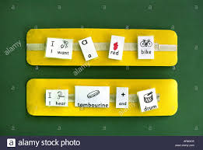
Moving to symbols
Where possible use advice from Speech & Language Services
Introduce the symbols one at a time so the child understands what it means
You could add the symbol onto the photo to help make the link
Ensure the symbols (and the photos) are available to everyone who works with the child to avoid frustration

Slide 8
Using a ‘Now’ and ‘Next’ board
Find photos / symbols for the first task/ event and place it in the ‘now’ space
Place photo/ symbol that will happen next in the ‘next’ space
When the first activity has been completed remove from the board and place into a ‘finished’ box or bag – this could be supported by Makaton sign
The symbol that is on the ‘next’ space can now be swapped over to the ‘now space
Repeat throughout the day at times of transitions

Slide 9
Photo / symbol Timetable
Create a bank of photos/ symbols for activities / events throughout the day (have spares!)
Make a blank timeline from left to right, using a Velcro strip
For identified children break up the day into key sessions
Remove each activity from the timeline as they are completed
Make sure you have a finished box
Support with Makaton sign

Slide 10
Choice Boards
Start with 2 visuals of activities, events or food the child likes
Place them on the choice board and help the child indicate which one they would like
Repeat back the choice “Daniel would like the cars”
Give the child the choice they have made

Slide 11
TEACCH Time
Place 2 or 3 activities in the green basket away from the child
Place the Velcro strip with the photos/symbols of what the child is expected to do.
Sit opposite the child
Show the child the strip, working left to right.
Ask them to give you the first activity (if needed, adult takes it) from the green basket
Demonstrate & use language firmly, to say what you want

Slide 12
TEACCH Time cont…
•When the task is finished (using hand over hand if necessary), praise child with “finished” and place in the red basket with the corresponding picture from the strip.
•Repeat…..praising overtly after each activity is finished.
•When all activities are finished say “all the work is finished” “good work”.
•Offer reward e.g. bubbles for a few seconds and then say “go play” or whatever the next focus is.

Slide 13
Remember!
Only place in the basket what the child can do.
Use the child’s interests
Do not allow the child to play with them at other times.
The child ALWAYS finishes the activity.
Praise all the time!

Slide 14
Transition Books
Collect photos of who is dropping the child off and collecting the child (Have the child in the photo smiling if possible)
Have photos of key events within the day
Create a zig zag book (number of spaces dependent on the child’s development)
Picture 1. Being dropped off, then key events, final picture being collected
Have one for home and one for the setting so children can see what is going to happened and when they get to go home
If the child is distressed, share the book – “We have done this, we need to do… and then you are collected”
If multiple people drop off or collect, have an area where their pictures can slip in and out

Slide 15
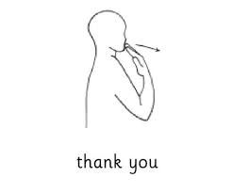
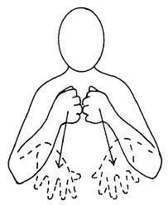
Thank you for listening

